Slide 1
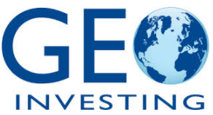
Short the Whole F***ing Thing
Going Long Gold to Be Short the Government’s “System” and Why I Have No Faith in Monetary Policy in 15 Minutes or Less
Christopher Irons
Quoth the Raven Research, LLC
GeoInvesting, LLC
cirons@geoinvesting.com
quoththeravensa@gmail.com
Twitter: @QTRResearch
Twitter: @GeoInvesting
May 3, 2018 – The Art of Short Selling

Slide 2
Introduction
It’s easy to be a short seller when you’re a skeptic and/or cynic by nature (growing up in a household with a low bullsh*t tolerance also helped)
Some people choose individual companies to short
While I also do this, I’m equally as skeptical about our government, our Federal Reserve and Central Banking policy globally
Driving policy based on spending and consumption instead of saving and underconsumption simply doesn’t make sense to me – not how I was raised
Best way to position against the system: own gold
May 3, 2018 – The Art of Short Selling

Slide 3
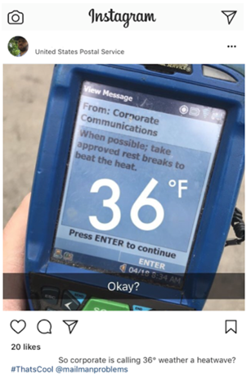
Gold vs. Government 30 Second Overview
Gold:
Finite supply
First used as money ~3000 years ago
Used to back the U.S. dollar until demand for gold redemptions became too overwhelming
Still held in reserve by Central Banks
History of holding its value
Hedge against inflation, global uncertainty, instability and basically any type of economic/monetary catastrophic situation you don’t think about on a daily basis
Government:
15 days ago sends my friend, who is a mailman, a heat advisory while he’s delivering mail in Buffalo. The temperature was 36°F outside.
May 3, 2018 – The Art of Short Selling

Slide 4
Shorting “The System”
To me, shorting “the system” means being diversified properly so in the event of a significant United States based (or global) economic crisis, currency crisis, sovereign debt crisis or crisis of monetary policy or economic theory, you’ll be hedged or poised to benefit – owning gold covers all of these scenarios
Many people carry “systemic hedges” as a very small weighting or small percentage of capital – if at all. The Siegels and Buffetts of the world will tell you to be 100% in stocks at all times and to buy all dips.
This isn’t necessary, it isn’t diversification, it requires no thought, in my opinion it’s generally insane and it’s a strategy only applicable to a Fed-insured rigged market that only goes up – like ours
My idea is to be overweight systemic hedges at all times – they don’t have to dominate your portfolio, but keeping a double digit weighting of capital in gold, silver and commodities like oil is a serious way to hedge against the system and the dollar – these are all things that Central Banks can’t print more of
May 3, 2018 – The Art of Short Selling

Slide 5
Is Now a Good Time to Short “the System”?
As long as the government is in charge, any time is a good time
Just think about the last thing you dealt with involving government – the DMV? the VA? the Post Office? the Healthcare Marketplace? the Tax Code? Was it efficient and pleasant? How about the IRS computers going down on tax day this year, reportedly affecting over 30 million returns?
Like many bubbles of years past, our economic system as it exists today is mostly a confidence game based on confidence in our monetary policy and the U.S. dollar
Global currencies are backed by the U.S. dollar, which is backed by – well, nothing.
Monetary policy has undergone a drastic shift over the last few decades with nearly no historical track record to back it up
Monetary policy has a ridiculous focus on deficit spending and consumption versus savings and underconsumption
You don’t need to be a PhD – think back to your first “savings” account as a kid. What was the point? Debt and spending?
We’re arguably at the top of a 10 year bull market in equities, the VIX appears to have woken up for first time in 10 years
Our current President – love him or hate him – is unpredictable and will guarantee further volatility
Oh, and we’re running TRILLION dollar deficits globally at an economic peak! Fun!
May 3, 2018 – The Art of Short Selling

Slide 6
Meet Your “System”
Insane monetary policy/regulation that is anything but free market capitalism
Bond markets and equity markets worldwide are rigged by Central Banks
Trying to curb short sellers is the first step for the U.S. to turn into Japan
Government regulates (interferes with) basically everything except what dipping sauces FINRA registered brokers are permitted to use for their chicken fingers at lunch (could happen in 2019)
Meanwhile, the government can’t cut spending, as both sides of the political aisle consistently promise
Bi-partisan jackassery ensures that more money will be printed as a “solution” and the debt ceiling will need to continue to be raised
The system encourages privatizing profits and socializing losses
This is why the 2008 TARP money went to banks and not into your wallet
At some point, the bailout “solution” will be a “problem” – and then we won’t have a solution – could be weeks/months/years/decades from now
May 3, 2018 – The Art of Short Selling

Slide 7
Pay Attention When the “Herd” Says You’re Crazy
Trust me, being long gold and/or shorting “the system” is the last thing people want to talk about 10 years into a euphoric bull market, which makes it even more appealing to me.
Few people have the fortitude or common sense to point this out – Peter Schiff and Bill Fleckenstein are two notable names. Neither is a regular in fin media
Last time Fleckenstein was on CNBC, Tim Seymour insulted him for being long gold
Peter Schiff predicted the 2008 housing crisis, was literally laughed at on air while doing so
The more people that say the “timing is crazy,” the more necessary I believe this line of thinking is – sure, it may not happen, according to economists and analysts but…
…the sayings “It can’t happen” and “It won’t happen” remind me of some of my favorite quotes…
May 3, 2018 – The Art of Short Selling

Slide 8
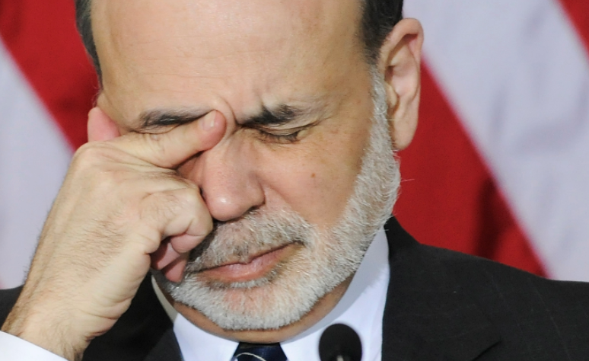
"At this juncture, however, the impact on the broader economy and financial markets of the problems in the subprime market seems likely to be contained. In particular, mortgages to prime borrowers and fixed-rate mortgages to all classes of borrowers continue to perform well, with low rates of delinquency."
- Ben Bernanke on Housing, March 2007
May 3, 2018 – The Art of Short Selling

Slide 9
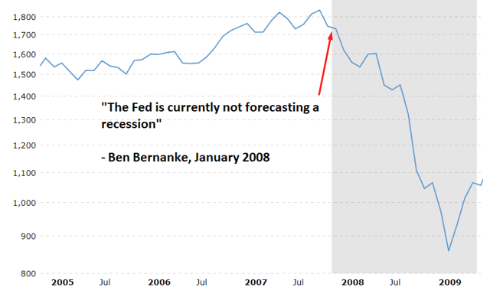
What About the Fed/Regulators/Economists?
May 3, 2018 – The Art of Short Selling

Slide 10
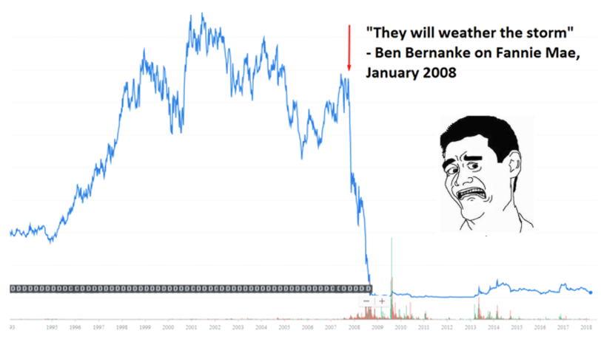
What About the Fed/Regulators/Economists?
May 3, 2018 – The Art of Short Selling

Slide 11
Other Great Quotes in Economist/Analyst History
Former National Association of Realtors chief economist David Lereah published a book called "Why the Real Estate Boom Will Not Bust—And How You Can Profit from It" early in 2006. It has not aged well.
In August 2007, Joseph Cassano, who ran insurer AIG's financial products division, said he couldn't see AIG "losing one dollar in any of those (credit derivative) transactions." AIG was bailed out in 2008.
In December 2007, Goldman Sachs chief investment strategist Abby Joseph Cohen suggested the S&P 500 would hit 1,675 by the end of 2008, a climb of 14% — it actually ended below 900.
“Two brokerage firms - RBC Capital Markets and UBS Warburg -- just downgraded Enron from a Strong Buy on Wednesday, after the stock already had fallen from a 52-week high of $84.87 to $4.14. Thanks for nothing.” – CNN Money, 2001
Sources: Reuters, Business Insider
May 3, 2018 – The Art of Short Selling

Slide 12
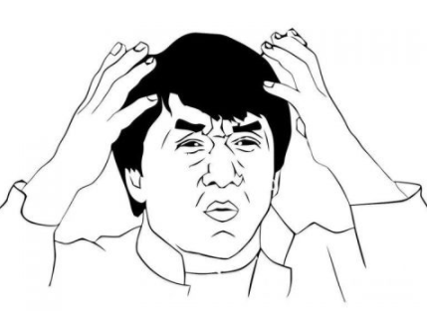
The Fed’s Answer to Any Problem? But remember: QE hasn’t “worked” unless we can unwind the stimulus and still be better off than we would have been.
"The U.S. government has a technology, called a printing press (or today, its electronic equivalent), that allows it to produce as many U.S. dollars as it wishes at no cost.”
– Ben Bernanke, November 2002
May 3, 2018 – The Art of Short Selling

Slide 13
Why does this happen over and over?
May 3, 2018 – The Art of Short Selling

Slide 14
Herd Mentality and Fear of Being Wrong
“If everyone is thinking alike, then somebody isn't thinking.” ― George S. Patton Jr.
“A bad conscience is easier to cope with than a bad reputation.” ― Friedrich Nietzsche
May 3, 2018 – The Art of Short Selling

Slide 15
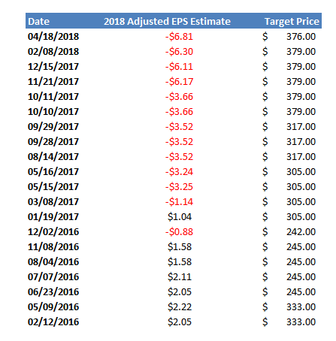
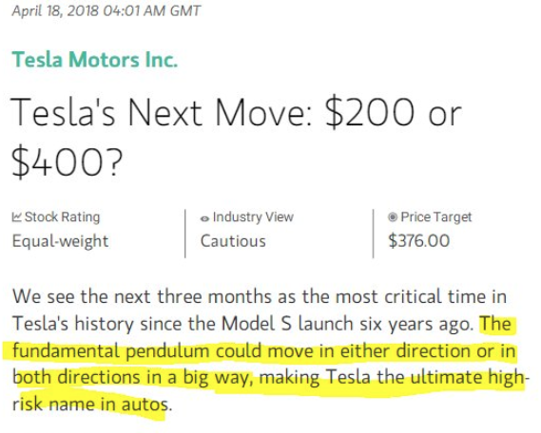
More Great Quotes in Analyst History
Adam Jonas, Morgan Stanley price targets and corresponding 2018 adjusted EPS estimates for Tesla.
DO YOUR OWN WORK – These analysts will not save you!
May 3, 2018 – The Art of Short Selling

Slide 16
The Analyst I Listen To
“Trust your own judgement, live with it and love it.”
– Nas
May 3, 2018 – The Art of Short Selling

Slide 17
Instead, Economists Ignore Nas and Are Buying Each Other’s Bullsh*t
“I am entirely sympathetic to the efforts of the Fed, this is a very hard time. But you should know that I am biased, because before he was promoted, Ben Bernanke was the Chairman of the Princeton economics department.”
- Paul Krugman 2008-09
May 3, 2018 – The Art of Short Selling

Slide 18
Results of Economist/Analyst Confirmation Bias
Majority of economists and analysts all think the same
Everyone continues to wind up trusting “the system” without looking at it critically – ever
Regardless of whether or not the unthinkable happens, this is dangerous
No one talks about, or pays attention to, the fact that our monetary policy is an unprecedented experiment – the outcome of which continues to remain unknown
Whistleblowers can go ignored (see: Harry Markopolos)
May 3, 2018 – The Art of Short Selling

Slide 19
Maybe the Government Will Catch On – Or Not…
Madoff – $65 billion fraud
Enron - $60 billion market cap (adj. for inflation ~ $88 billion today)
WorldCom – inflated assets by $11 billion
Chinese Reverse Mergers – over $15 billion in fraud uncovered
Theranos - $9 billion valuation wiped out
Lehman – hid over $50 billion in loans disguised as sales
Waste Management - $1.7 billion in fake earnings
Tyco, Volkswagen, Autonomy, Nortel, WaMu, Bear Sterns, Bre-X (Canada), etc. etc etc.
May 3, 2018 – The Art of Short Selling

Slide 20
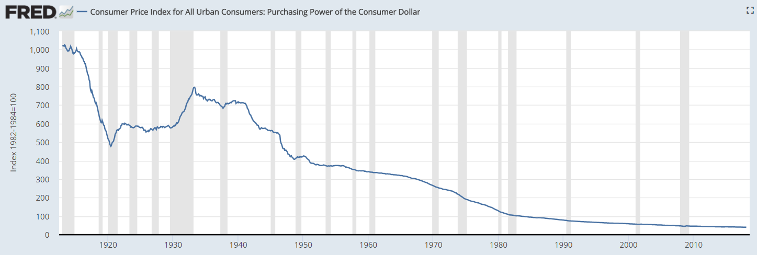
Long Gold to Short the System
Gold as a store of value versus the U.S. dollar (other commodities similar)
A store of value is the function of an asset that can be saved, retrieved and exchanged at a later time, and be predictably useful when retrieved. More generally, a store of value is anything that retains purchasing power into the future. It is finite in supply, unless the U.S. dollar printing press.
“…at no cost”
- Bernanke, 2002
May 3, 2018 – The Art of Short Selling

Slide 21
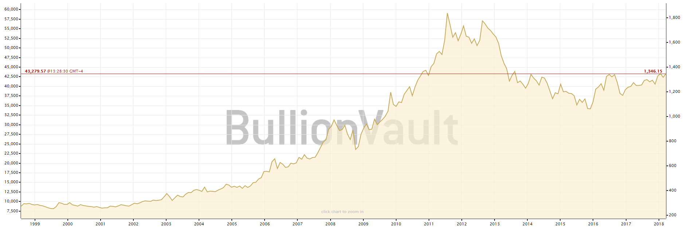
Long Gold to Short the System
Measured in U.S. dollars, it’s clear that gold has maintained its purchasing power
May 3, 2018 – The Art of Short Selling

Slide 22
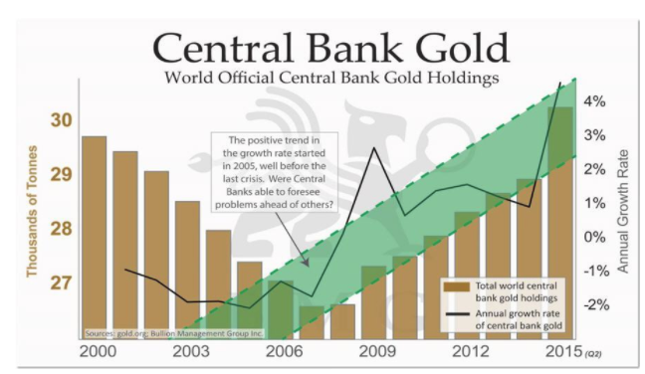
Economists Downplay Gold But It’s Held in Reserve…
Easy question: if gold isn’t that important – as economists and financial pundits sometimes say - why do the world’s central banks still hold it in reserve?
To manage risk
To promote stability
To hedge against the USD/inflation
To hedge against “the system”
Do the same in your portfolio.
The same economists telling us that
gold isn’t money are the ones shilling
for the central banks that are buying.
May 3, 2018 – The Art of Short Selling

Slide 23
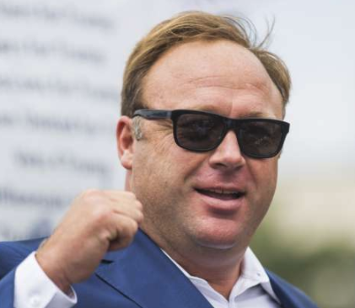
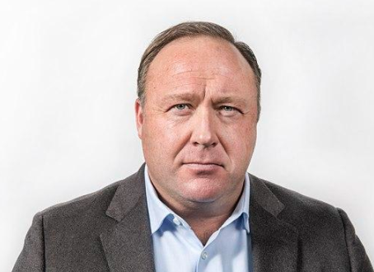
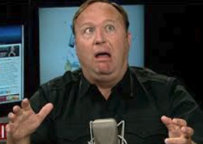
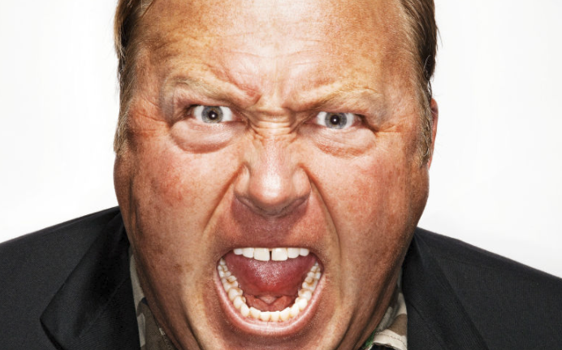
How To Own It?
Having exposure to bullion is best, if you have the means
You don’t want to be stuck holding GLD or some gold ETF or gold related stock if there’s going to be a systemic shock
If the owner of your gold ETF is smacked hard during systemic shock, you’re now officially holding shares of The Weinstein Company or Theranos instead (read: $0).
Depending on your level of tin foil hattery, you may seek to purchase gold that is held in a vault either in the U.S., or outside of the U.S. (Switzerland is popular & highly regarded as safe)
Investment Vehicle
Gold miner stocks Gold ETFs Gold futures Physical Bullion
Riskier
Less Risky
Alex Jones Conspiracy Meter
May 3, 2018 – The Art of Short Selling

Slide 24
The “Pain of Short Selling”
When you speak up against the “herd” everybody usually will tell you that you’re wrong about everything
You’re often viewed as the “bad guy” by people who don’t understand what you’re talking about or people who are charged with just coming up with hot takes (see: financial media)
You have to get the facts, timing AND the psychology of the market right, or you will get your head crushed in like I did on:
Questcor/Mallinckrodt – right thesis, was 3 years early (cc: David Einhorn, Andrew Left)
Herbalife – still think facts are correct, stock thinks otherwise
Green Mountain Coffee – bought out at nearly 100% premium and shortly thereafter wrote down the Keurig Kold, one of the main reasons I was short
May 3, 2018 – The Art of Short Selling

Slide 25
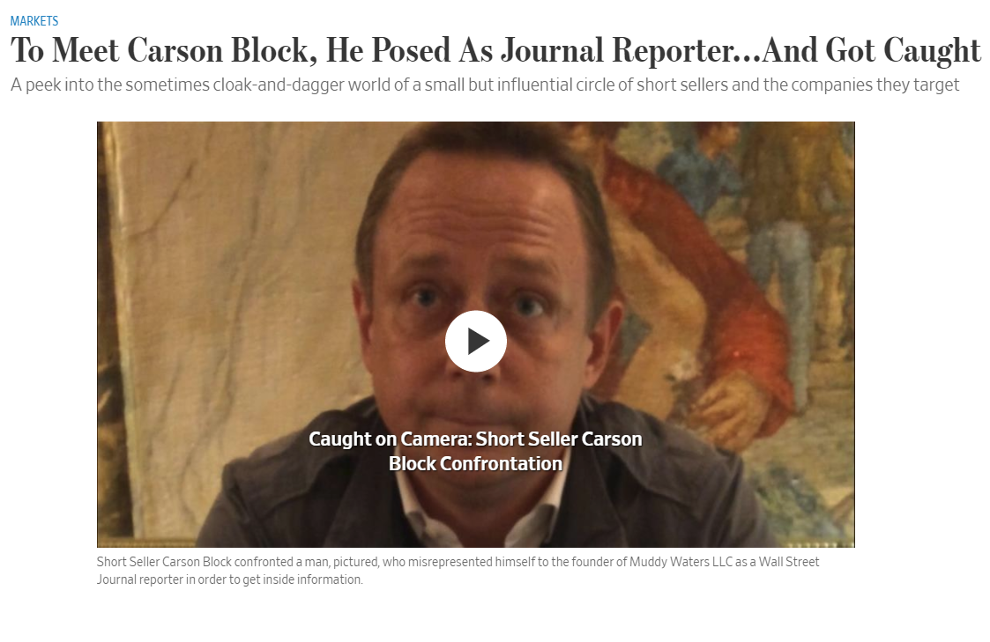
The “Pain of Short Selling”
“Brain damage” - companies that don’t like the truth will sue you, hire private investigators or “business intelligence” firms to perform counter-intelligence/spy on you
May 3, 2018 – The Art of Short Selling

Slide 26
The “Art of Short Selling” & Lessons
You absolutely must trust your own research & instincts
Your research must be 100% error proof and rock solid, backed by facts
You must be ready for psychological twists and turns
Must have the fortitude to swim against the current & take on major risk
You have to be nuts - as Marc Cohodes says “have a genetic defect”
Next time a short seller/skeptic speaks, you don’t have to agree, but it’s probably worth it to at least listen and consider
Billions in U.S. listed China based fraud uncovered by short sellers
Harry Markopolos blew the whistle on Madoff years before he went bust, no one listened
Austrian based economist Peter Schiff predicted the housing collapse
May 3, 2018 – The Art of Short Selling

Slide 27
Thank You
Christopher Irons
Quoth the Raven Research, LLC
GeoInvesting, LLC
cirons@geoinvesting.com
quoththeravensa@gmail.com
Twitter: @QTRResearch
Twitter: @GeoInvesting
May 3, 2018 – The Art of Short Selling

