Slide 1
Planet MicroCap Showcase April 22, 2020 Gary E. Medved, CEO/President

Slide 2
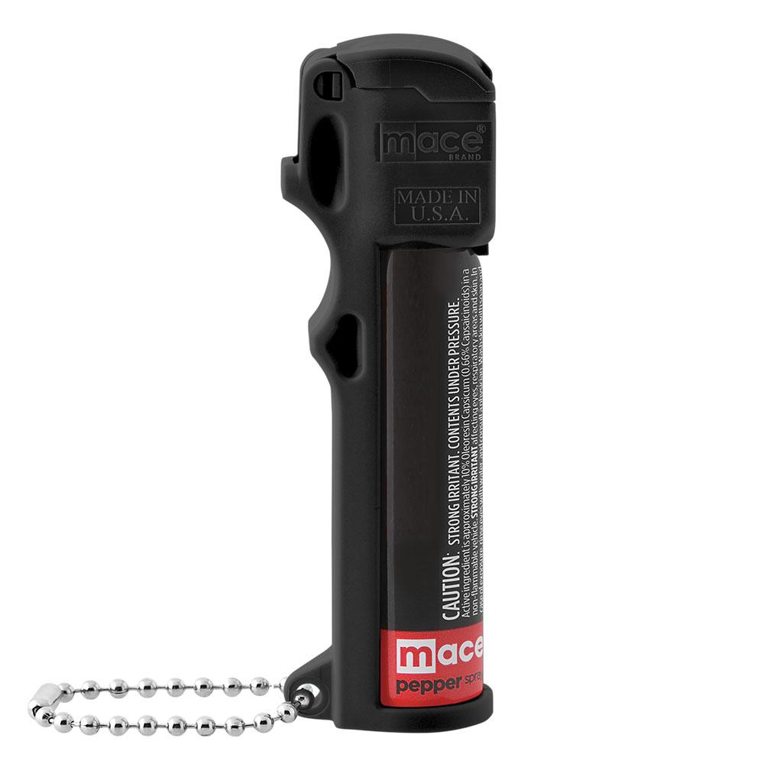
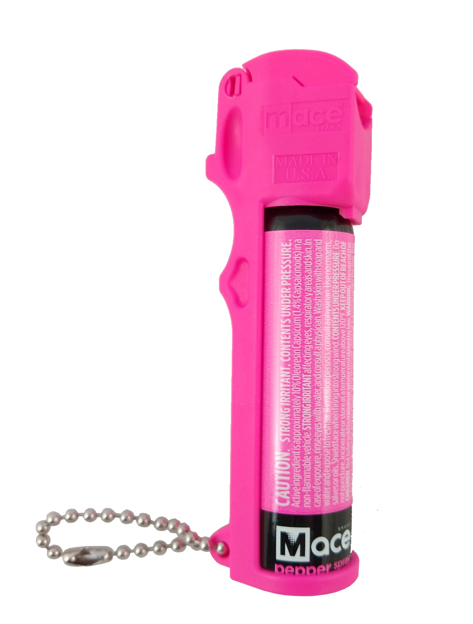
Mace. We invented Social Distancing.

Slide 3
We are THE BRAND

Slide 4
Introduction to Mace Security International, Inc. (OTCQX – MACE)
Mace Security International, Inc., located in Cleveland, Ohio, is a manufacturer and provider of personal safety and security products to consumer and law enforcement markets worldwide.
Mace® Brand is the original manufacturer and market leader in the defense spray segment, and has over 40 years experience developing aerosol defense spray dispensing technologies for both the consumer and tactical markets around the world. The Company also markets products through the well respected Vigilant (R), Tornado (R), and Takedown (R) Brands.
Mace® directly distributes and supports its branded products through strategically targeted customer channels that include selected retailers, wholesale distributors, independent dealers, e-commerce channels, and our website, Mace.com.

Slide 5
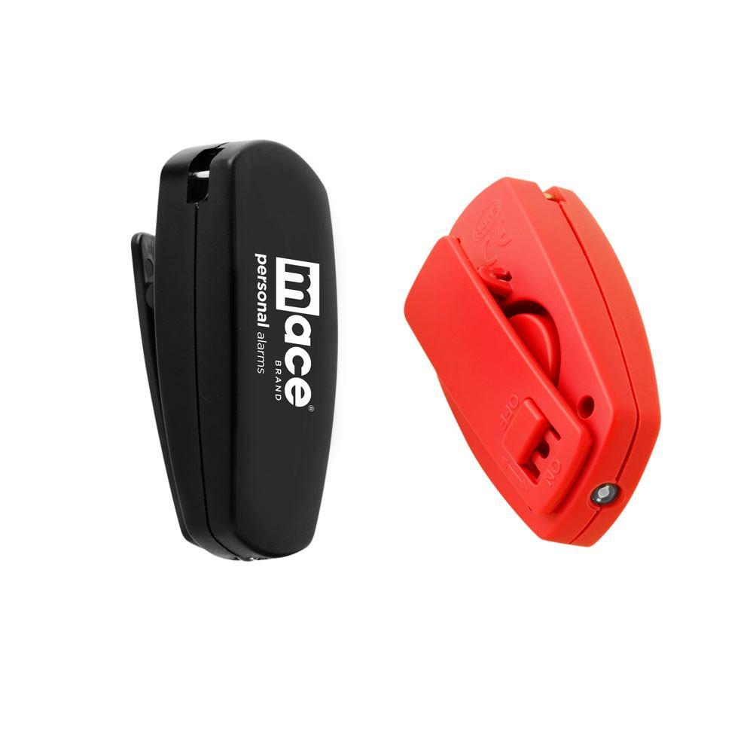
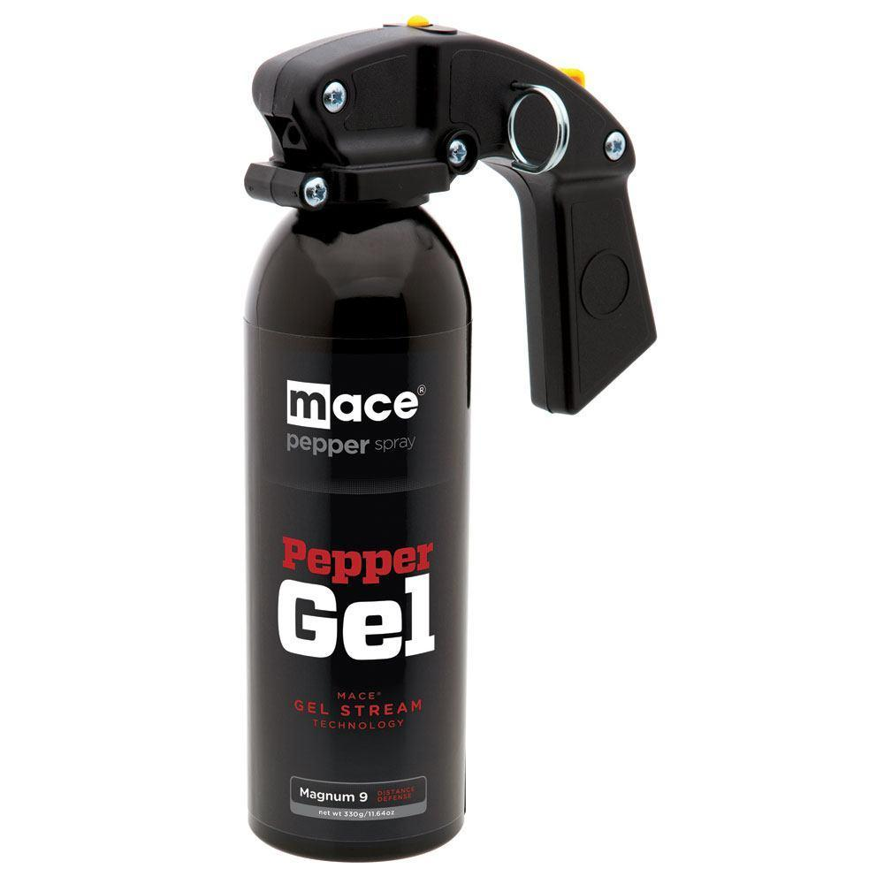
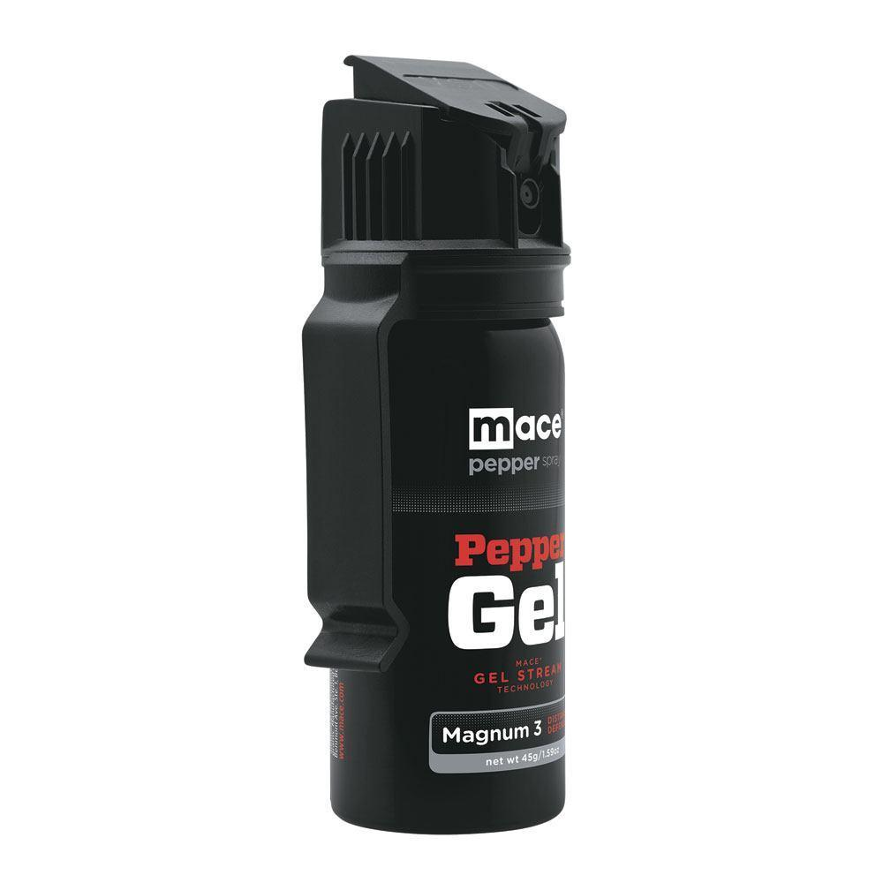
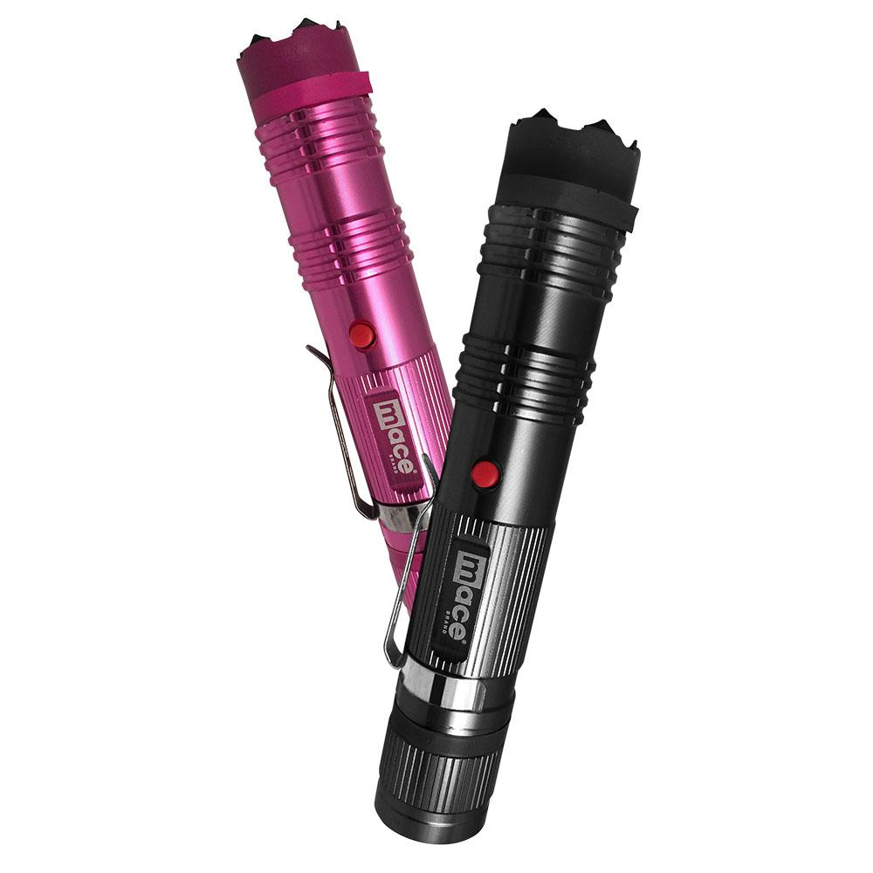
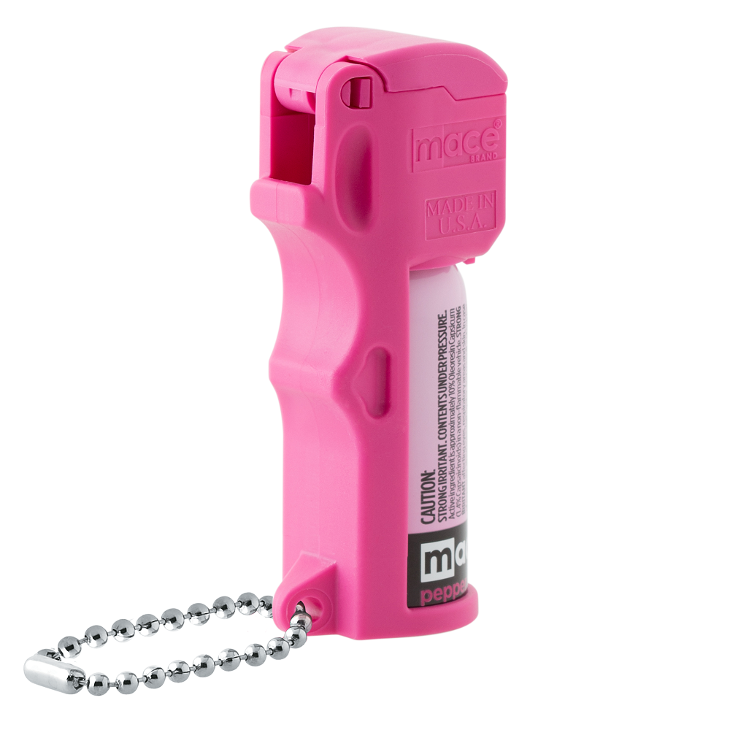
Current Product Lineup
Personal Alarms
Pepper Gel
Stun Guns
Pepper Spray

Slide 6
Brand Awareness (Among Male Buyers, Armed Women, and Unarmed Women)
Source: Nottingham-Spirk Consumer Insight Survey March 2020

Slide 7
Brand Comparison
 | Strong Brand Recognition | Original & Authentic | Product Innovator | Quality Level | Retail Price Point | Retail Margin | DTC Sales Leader | Amazon Sales Leader
Mace Brand |  |  |  | High | Premium | High
Sabre |  |  |  | Medium | Opening Price Point | Medium
Others |  |  |  | Med-Low | Med-Low | Med-Low | O.K. | O.K.

Slide 8
Brand Awareness (Searches per Month for “Mace”)
Source: Semrush March 2020

Slide 9
Current Sales Distribution

Slide 10
Logistics/Supply Chain advantages
Mace has long history of foreign supply chain expertise, and established relationships with low cost, high expertise product sources in China (mainland), Taiwan, India, and Hong Kong
US raw materials can be sourced from a variety of vendors
Proprietary formulas and components
Significant In-house packaging and design expertise
Low cost manufacturing with plentiful sources of materials and labor
Manufacturing is not capital intensive, and low investment in manufacturing facilities (leased building/machinery)
.

Slide 11
We are THE BRAND
Iconic Brand with Superior Brand Name Recognition
80% Brand Name Recognition
Leader in Search Terms
Opportunity to License Brand Name
Safety Products
Safety Technologies

Slide 12
Favorable Climate for
Non-Lethal Personal Safety and Security Products

Slide 13
Trends in the US
For the past 20 years 22-29% of US adults were victims of crime
Every year nearly 10,000 women on college campuses are victims of forcible sex offenses
61% of women check the back seat of their car before driving away
31% of women avoid walking by boys or men
Nearly 20% of women using an online dating site are threatened with physical harm
And more…

Slide 14
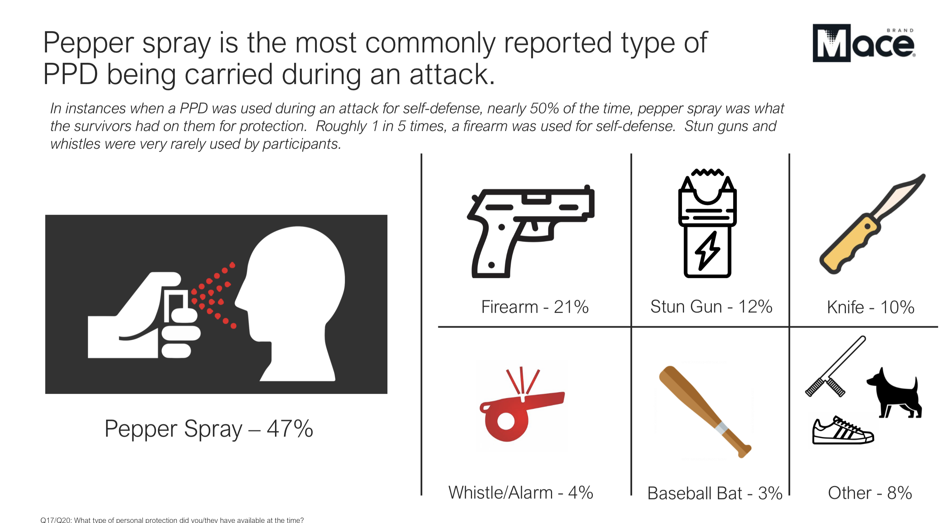
Preferred PPD

Slide 15
Make Our Communities Safer

Slide 16
Huge Untapped Market and
The Fear Gap

Slide 17
Addressable Market - USA
Home Sphere
(Fear Gap)
128M households in America
Work Sphere
(Fear Gap)
Professional Sphere
(Fear Gap)
5.6M employer firms in USA
99.7% are less than 500 employees
209M+ citizens over the age of 18
Social Sphere

Slide 18
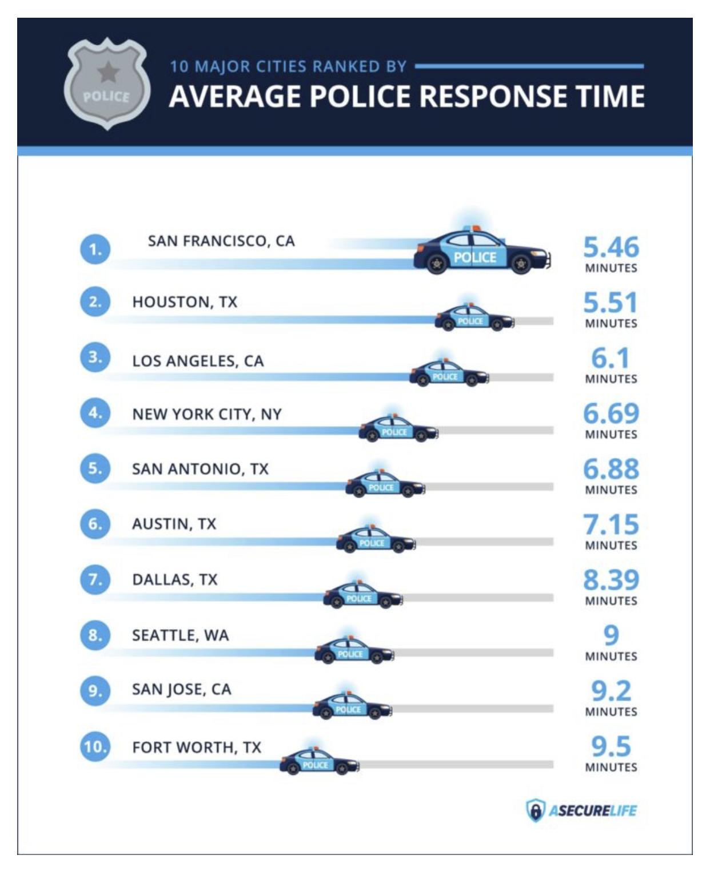
Addressable Market - USA
Home Sphere
(Fear Gap)
128M households in America
Work Sphere
(Fear Gap)
Professional Sphere
(Fear Gap)
5.6M employer firms in USA
99.7% are less than 500 employees
209M+ citizens over the age of 18
Social Sphere

Slide 19
Addressable Market - USA
Home Sphere
(Fear Gap)
128M households in America
Work Sphere
(Fear Gap)
Professional Sphere
(Fear Gap)
5.6M employer firms in USA
99.7% are less than 500 employees
209M+ citizens over the age of 18
Social Sphere

Slide 20
Ample Acquisition Opportunities
Recent acquisitions enhanced specific product channels – custom manufacturing, personal alarms, Tornado Brand
Potential roll-ups of customers/distribution channels
Potential industry consolidation
Industry leadership position makes Mace attractive acquiror
.

Slide 21
Consumer Insight Survey
Conducted nationwide by Nottingham-Spirk 1Q20
Insights used for product & content development
Key Insights
Target Demographics Identified
Awareness & Educational Opportunities
Product Design Elements

Slide 22
Innovative New Product Growth

Slide 23
Innovation: Products that are patentable, relevant, and value-add to the end user
Home Sphere
(Fear Gap)
New
Customers
Existing
Customers
Focused Innovation Using Consumer Insights
Professional Sphere
(Fear Gap)
New Products
+ Insights
Existing
Products
Social Sphere

Slide 24
New Retail and Digital Strategies

Slide 25
Retail: Consumer-Centric
Launched Spring 2020
Full Product Continuum introduced (showing double-digit growth)
Packaging and Product Refresh
Price Point Strategy – use of Tornado Brand
Goal: Develop a Personal Safety Category at the Retail Level (currently none exists)

Slide 26
Current Product Development Pipeline
.
Recently completed Consumer Insight potential opportunities:
Increase educational opportunities especially for non-users of PPD
Make products easier to use
Products for potential home use
Leverage search frequency of Mace ® Brand in eCommerce
Expand Tornado as entry price point Brand in certain channels

Slide 27
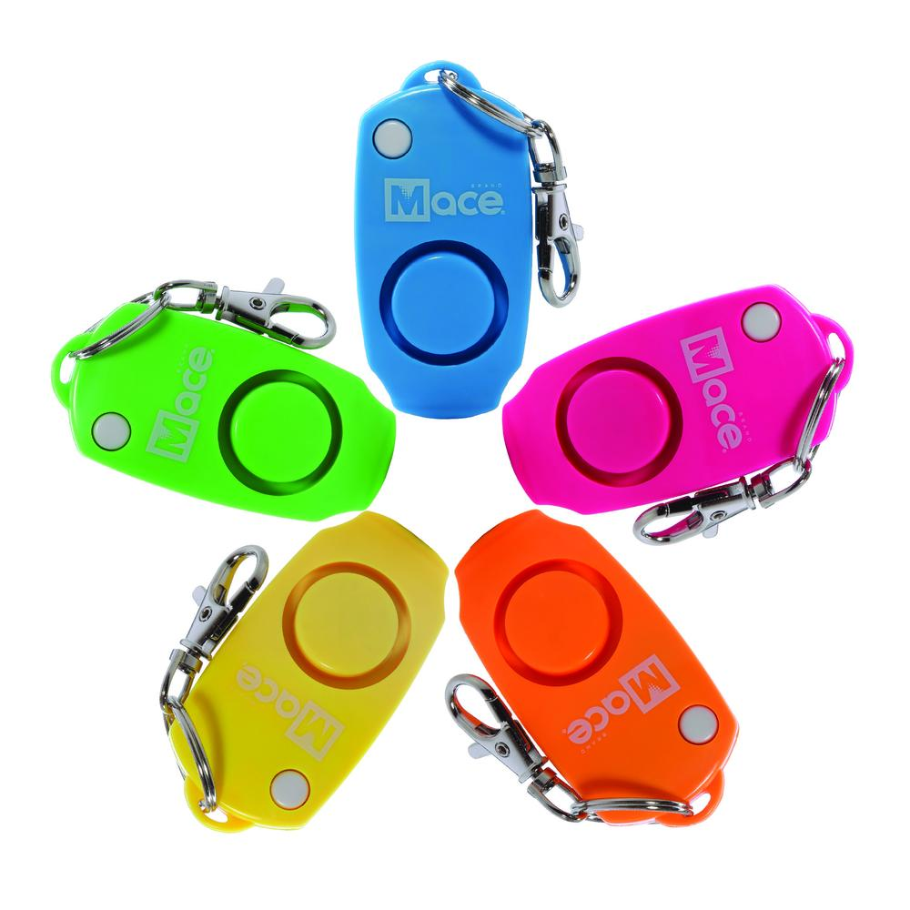
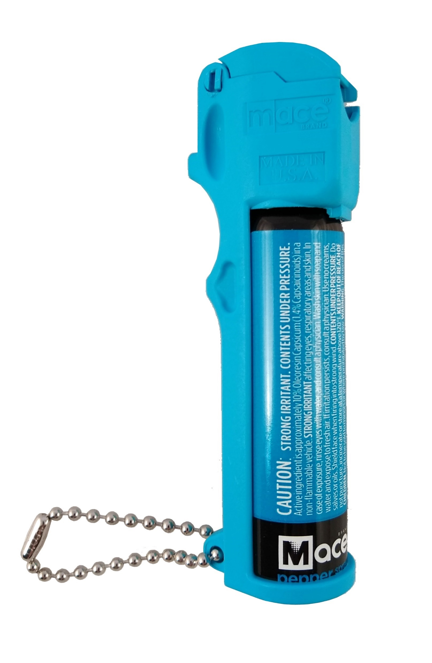
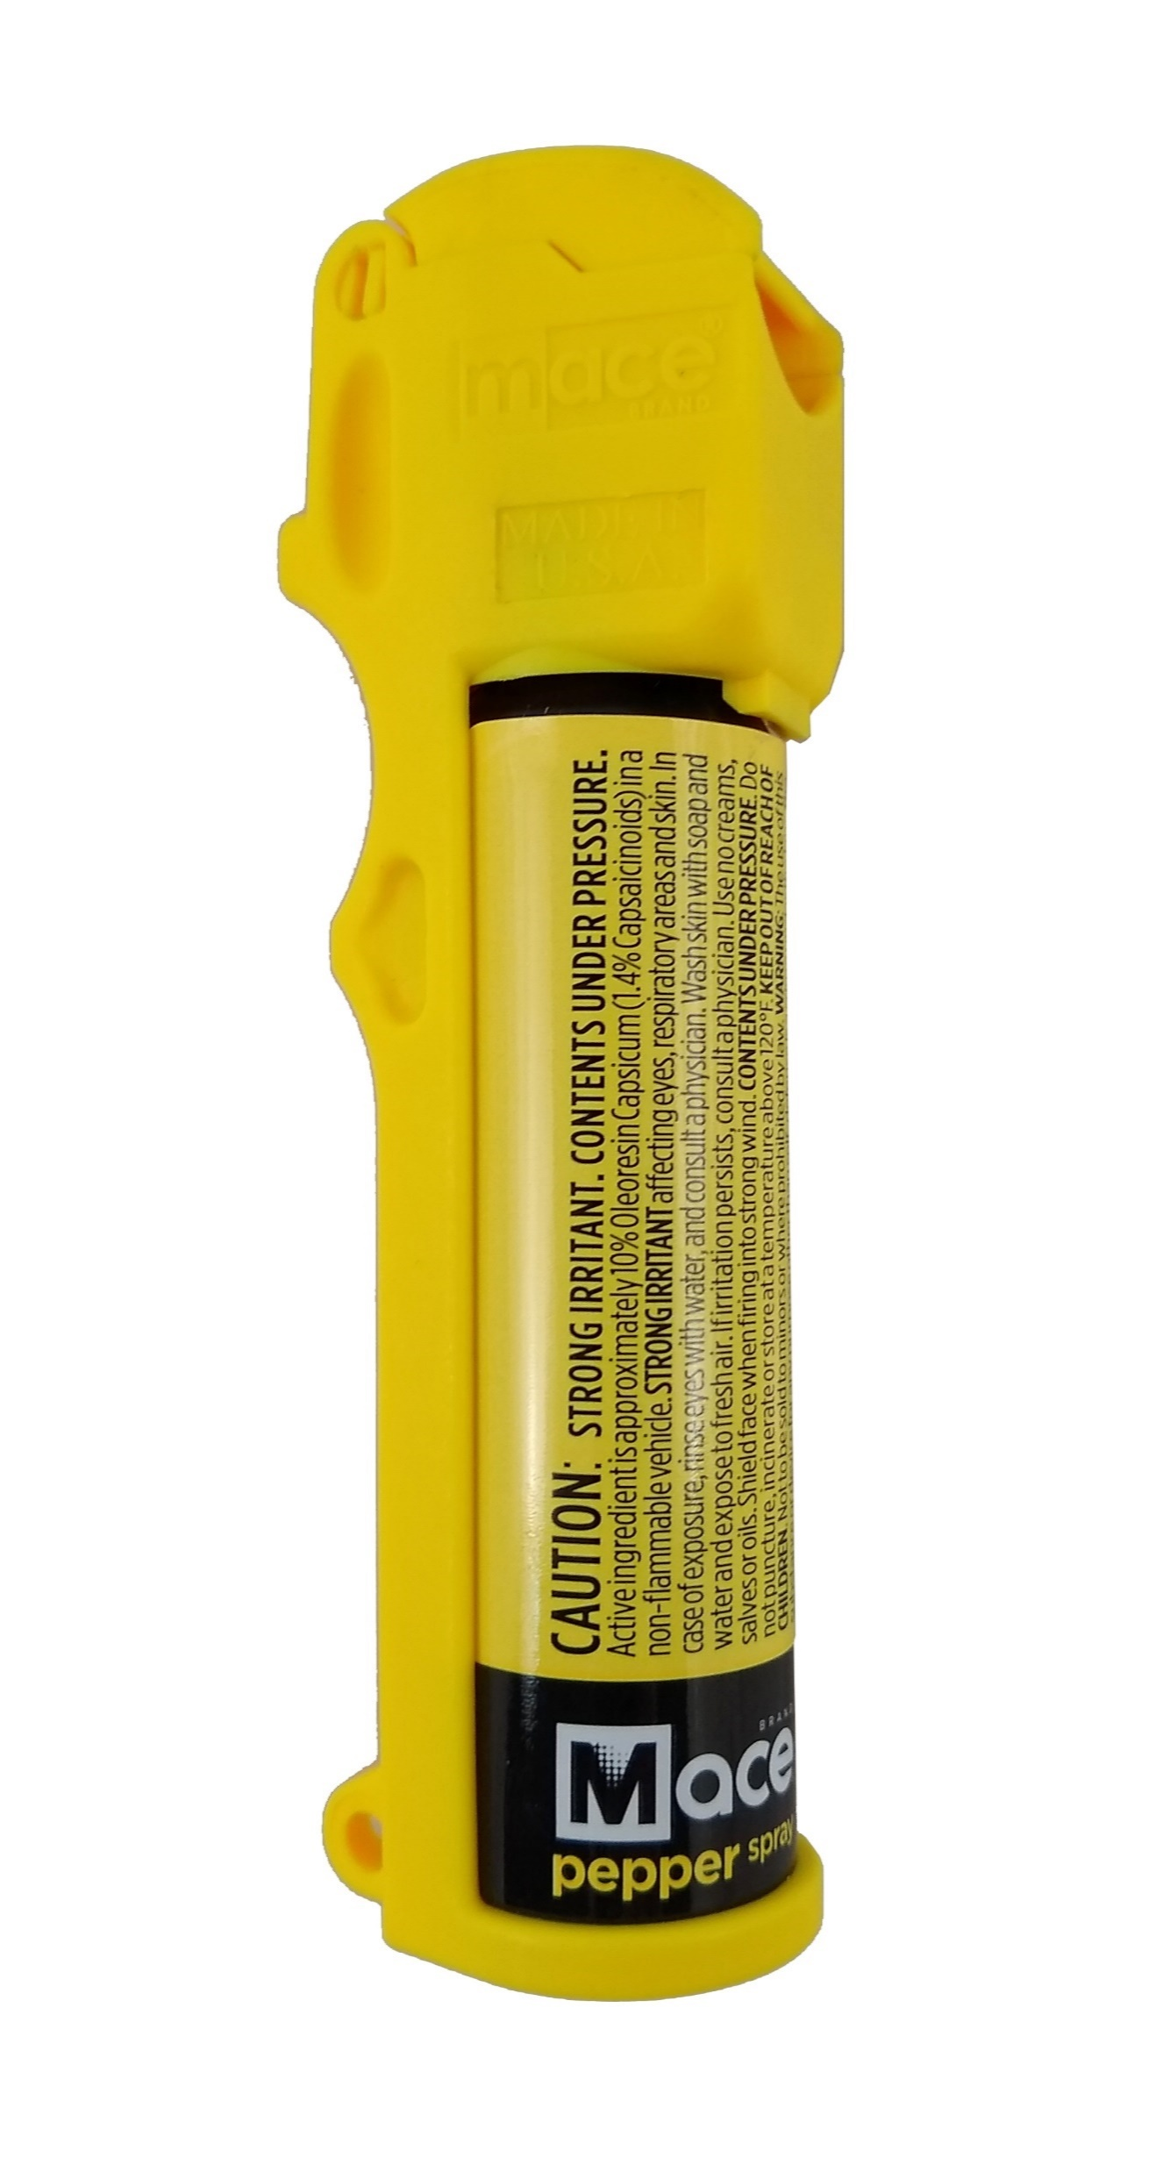
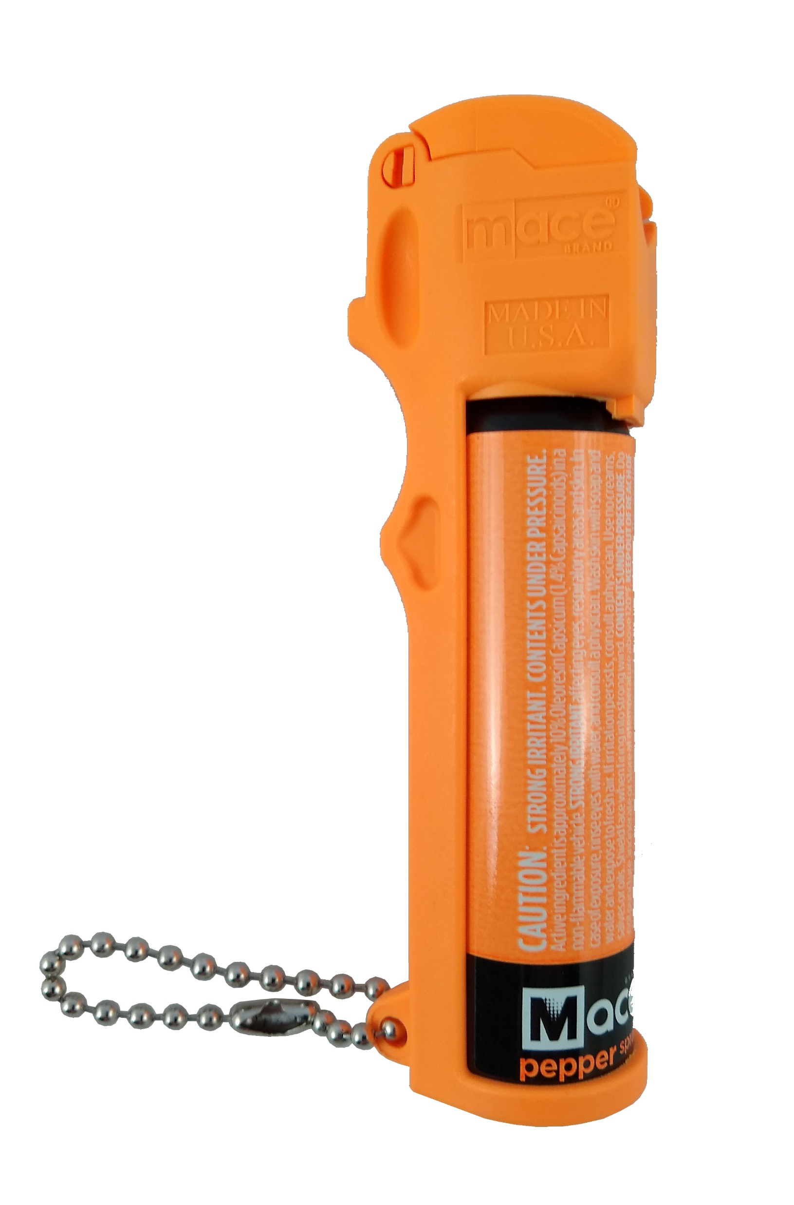
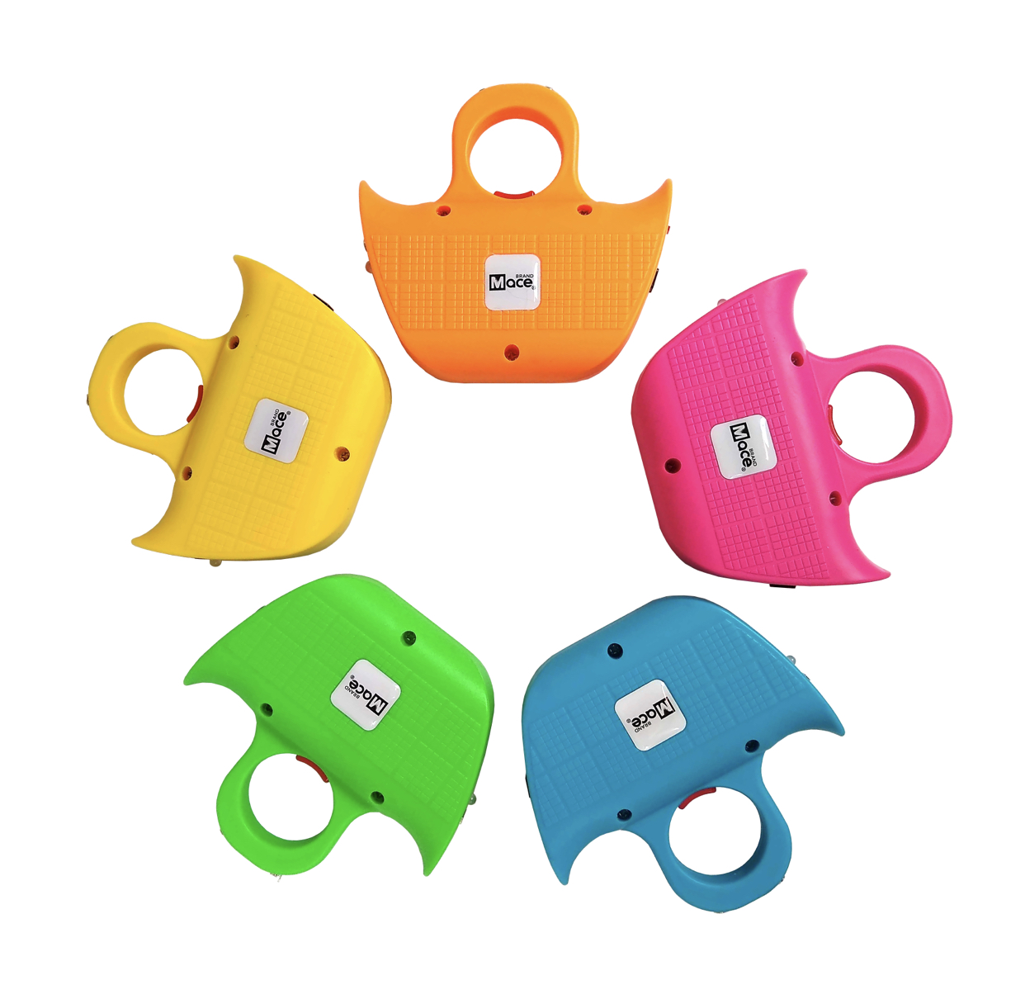
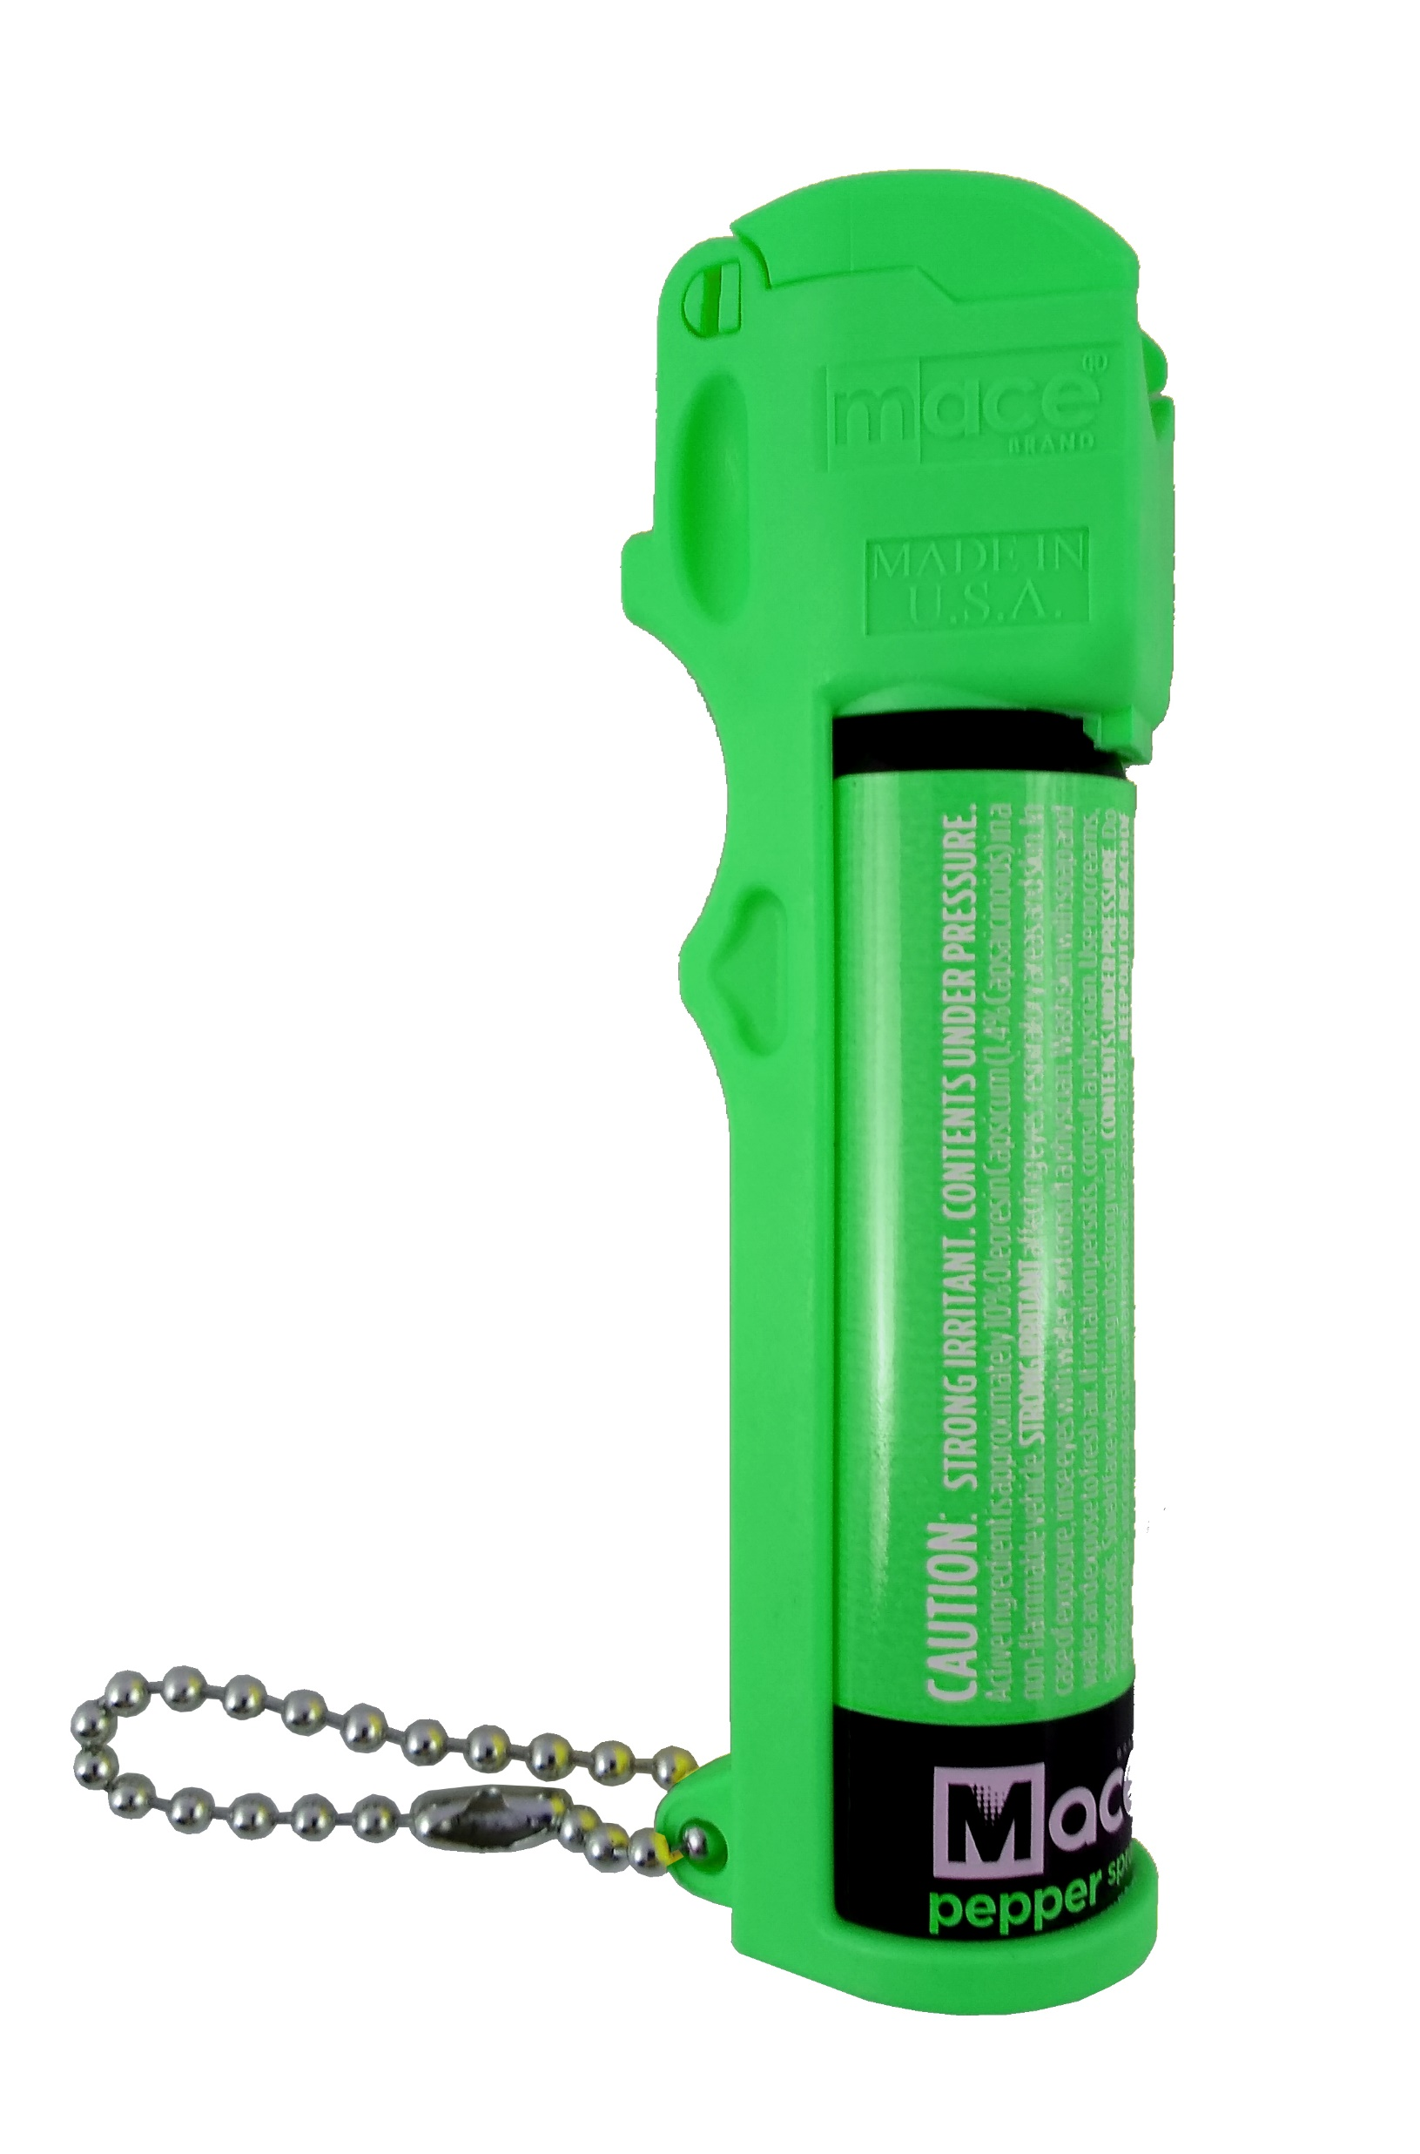
Product Line Refresh
New Product – easy to understand and simple to use!

Slide 28
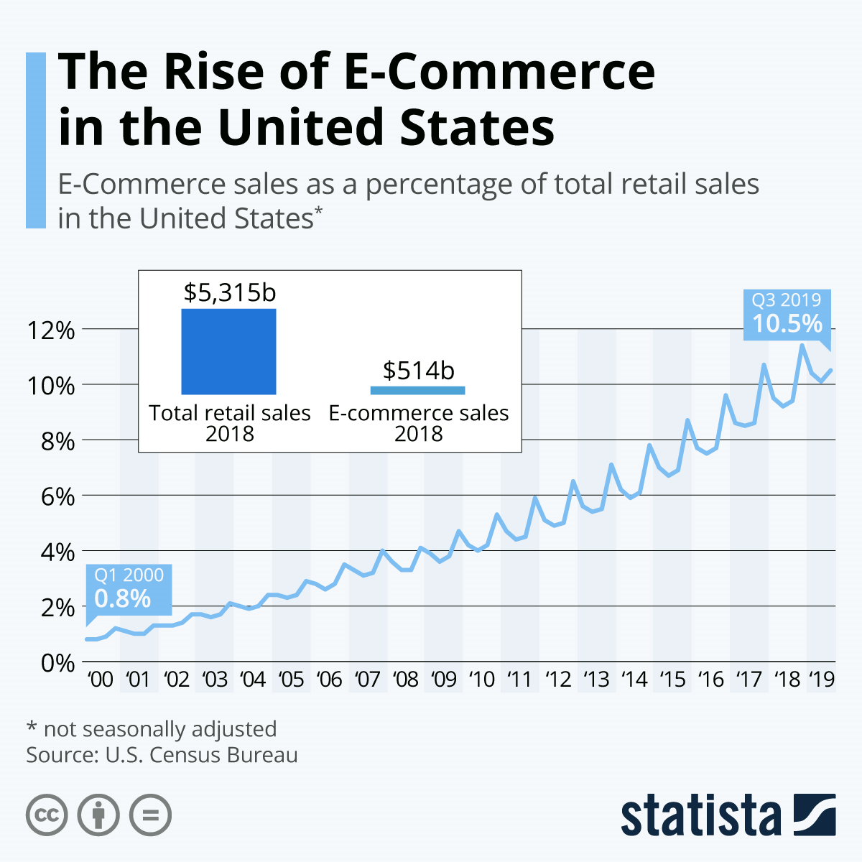
Digital Marketplace Opportunity
Mace 2019 eCommerce sales are only 13% of total sales – significant upside
Ecommerce gross margins are
Typically 1.5 to 2X retail

Slide 29
Digital: Content Development
Website scalable for increased sales
Completed in 2019/Q1202:
Amazon content upgrade
Website buildout
Launch Awareness & Education Campaign – 2Q20
Personal Safety
Personal Safety Products
Personal Safety Products Brands
Develop New Content across all platforms
www.mace.com
Social Media
Google
Amazon
Goal: Become the Personal Safety Expert

Slide 30
Attractive Financial Characteristics

Slide 31
Investment Thesis
Market leader in Brand Awareness
Favorable Climate for Non-Lethal Personal Safety and Security Product
Conservative balance sheet, low capital intensity, access to capital markets
Improved SG&A discipline under new management lowered break-even point and allows future revenue increases to fall to bottom line
Transparency in governance and public reporting

Slide 32
Conservative Capital Structure
As of May 2020, Mace’s capital structure was (thousands $):
$217 Term debt due < 1 year
$600 Bank Revolver due < 1 year
$229 Term debt due > 1 year
~$240 PPP loan due > 1 year
Total short term and LT debt = $1,330
Cash on hand ~$1,300
.
Interest rates are fixed at 2-5% and are pre-payable without penalty

Slide 33
Improving Financial Performance
 |  |  | Quarterly Sequential Improvement
Amounts (000), unaudited |  |  | Q1 2019 | Q2 2019 | Q3 2019 | Q4 2019 | Q1 2020
Net income (loss) |  |  | (856) | (606) | (161) | (77) | 120
Adjustments:
Interest expense |  |  | 14 | 17 | 14 | 11 | 11
Interest income |  |  | (4)
Income tax expense |  |  |  |  |  | 3
Depreciation and Amortization |  |  | 110 | 108 | 111 | 108 | 109
EBITDA |  |  | (736) | (481) | (36) | 45 | 240
Severance |  |  | 277 | 8 | 14
Nonrecurring Receivable loss and other |  |  |  | 462 | 22 | 25
Stock Compensation |  |  | 236 | 6 | 9 | 9 | 30
Adjusted EBIDTA |  |  | (223) | (5) | 9 | 79 | 270
New Management
January 2019

Slide 34
Additional Investment Insights
NOL Analysis: Company has approximately $56M in tax NOL carryovers, or $0.88 per share of (gross) NOL
Less than $8M expiring by the end of 2022.
Additional opportunities to monetize NOLs include licenses or royalties, strategic partnerships, or tax shield for acquisitions
Mace follows transparent public reporting, strong governance through diverse, independent BOD elected annually
.

Slide 35
Thank You!

