Slide 1

Algorithmic Trading Models for Novavax, BioNTech and Moderna
Introducing Oscillator Trading.
By Sarel Oberholster
14 December 2021

Slide 2
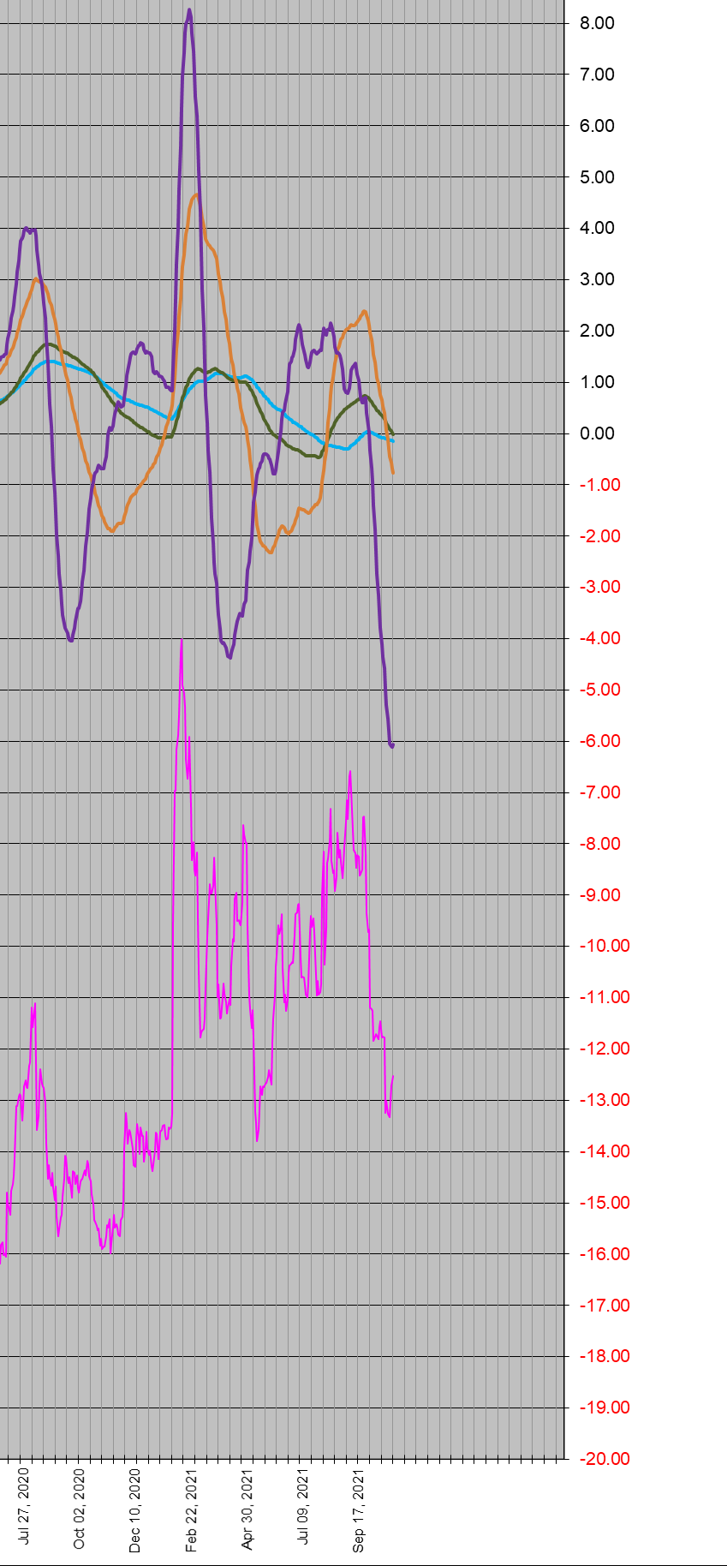
Light blue is the 15mth oscillator and it is still going down
Novavax model at around 26 Oct 2021
Green is the 12mth oscillator and it is still going down
Orange is the 6mth oscillator and it is still going down
Putting in a bottom turn on the 3mth purple oscillator
Pink is the share price

Slide 3
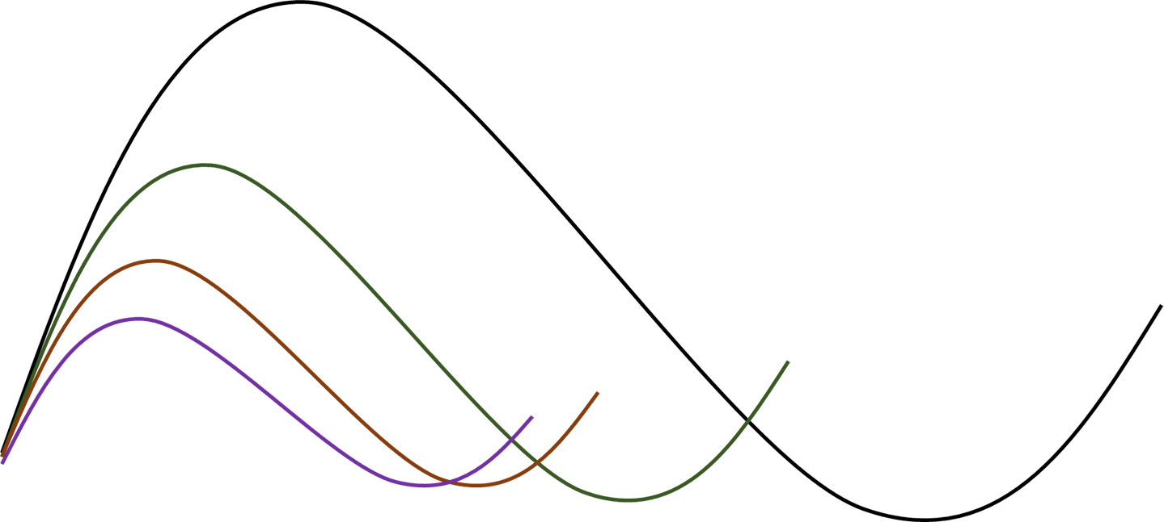
Oscillator topping = risk of a market leg DOWN
The more oscillators align the better the setup.
The inherent logic is that one wants to buy inside a longer-term trend and sell when that trend no longer applies.
Oscillator bottoming = risk of a market leg UP
The more oscillators up the better the setup

Slide 4
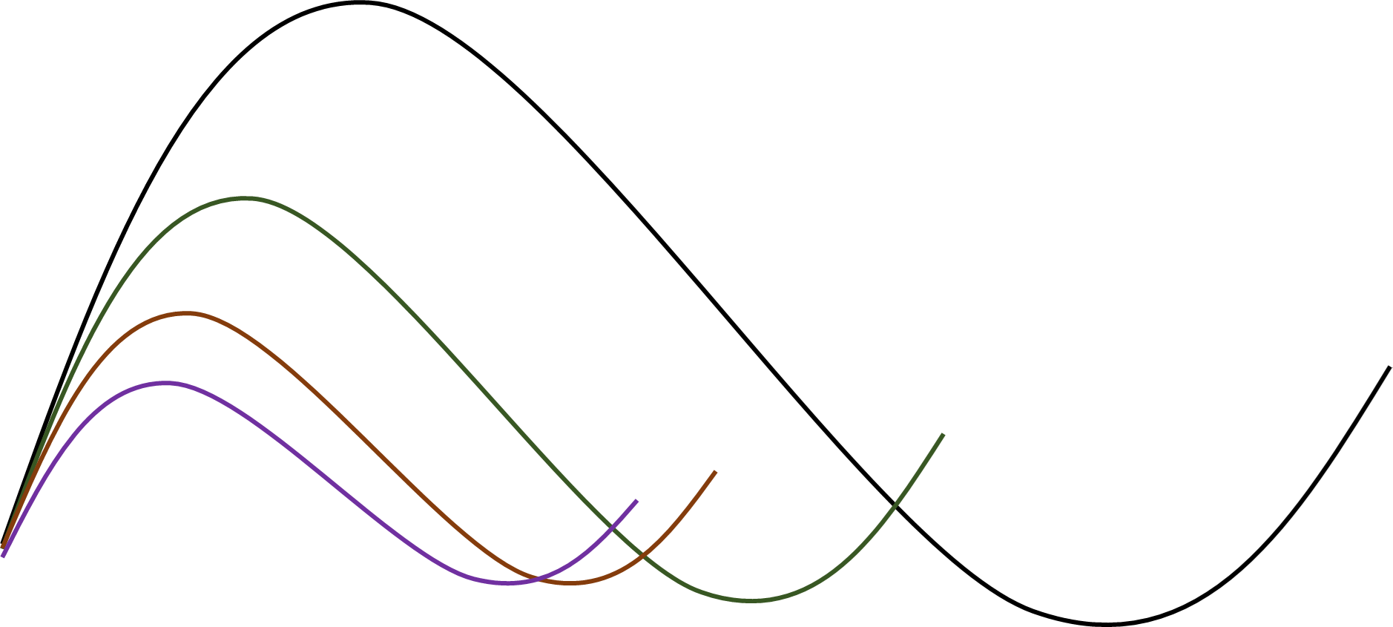
Ideal situation: All the oscillators align in an up move

Slide 5
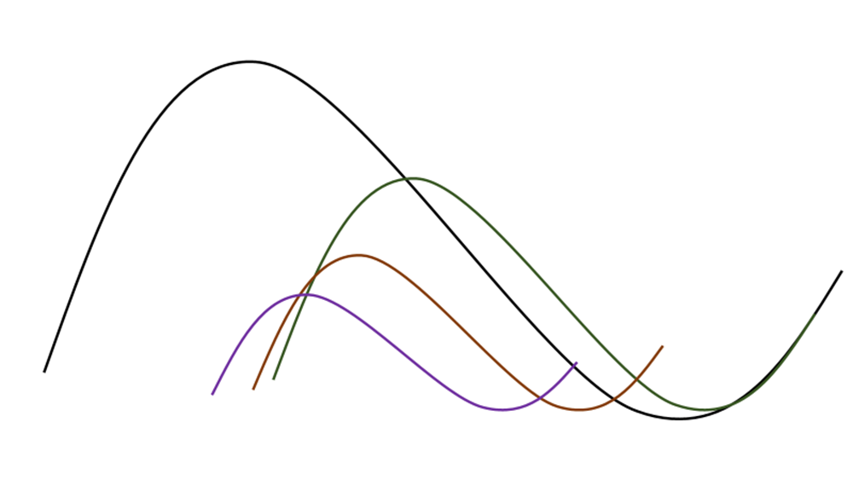
Not so ideal situation: The short oscillators align in an up move before the long oscillators and indicate the possibility of another leg down before all oscillators are in alignment as the long oscillators are still in the down phase.

Slide 6
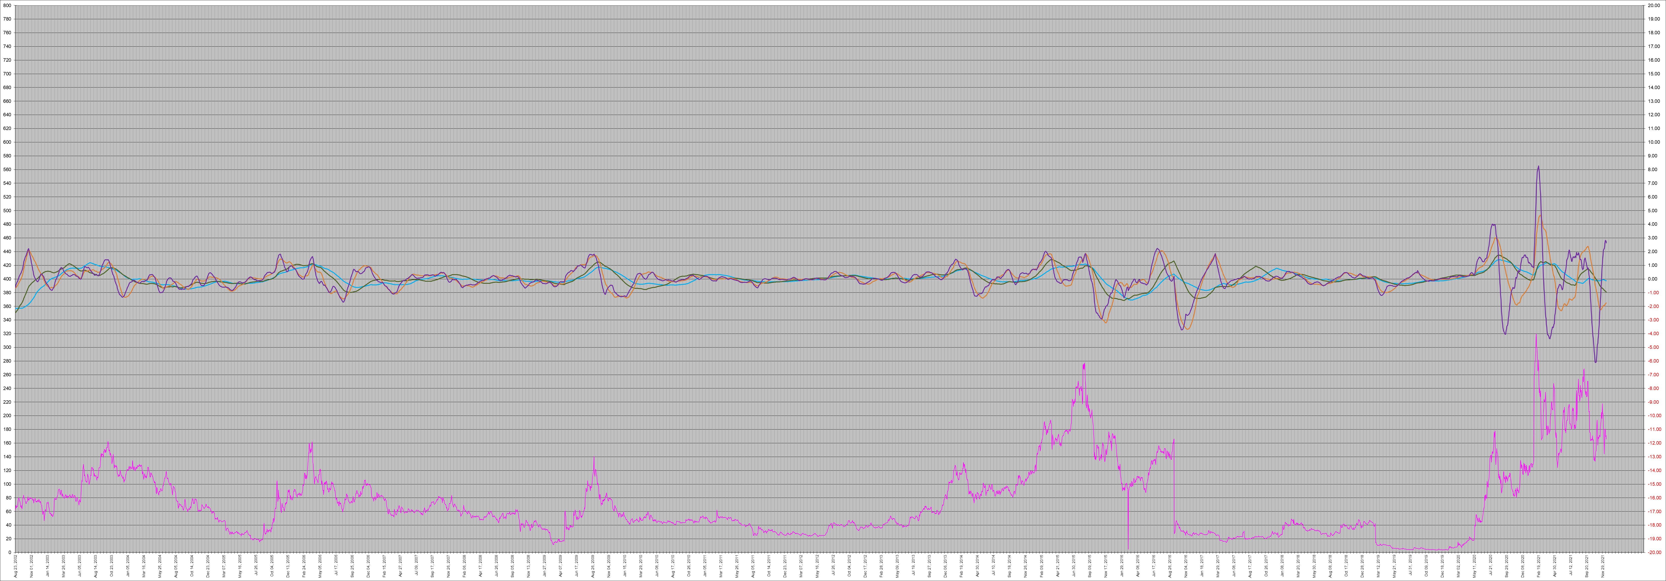
The Novavax full historical model to 14 December 2021
The price in pink is read off the left primary axes and the oscillators are read off the right secondary axes (oscillating around “0”)

Slide 7
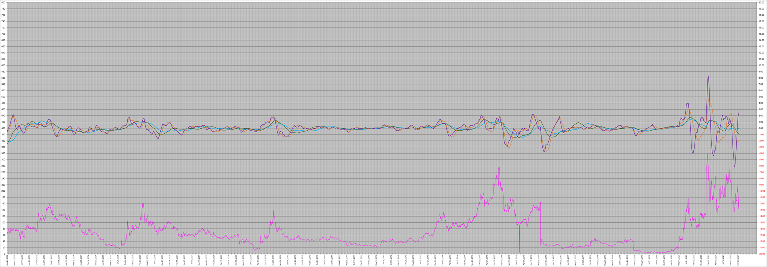
Light blue is the 15mth oscillator and it also went up a little bit but is going down again
The interpretation of the model as at 9 Dec 2021.
News of an EMA approval pushed the share price up by 28% on 7 Dec but the short leg down is still in play. See how the up move in the short oscillators happened while the long oscillators were still going down for a weak setup as explained above.
NOTE: The model cannot predict the effect of an unknown event such as an EMA approval which may make a sharp bottom turn or move against the trend.
Green is the 12mth oscillator and it is still going down
Orange is the 6mth oscillator and it is doing a yo-yo up and down
Putting in an extended top turn on the 3mth purple oscillator
Pink is the share price

Slide 8
Light blue is the 15mth oscillator and it is still going down
The interpretation of the model as at 14 Dec 2021.
The down leg is still underway. The 3mth oscillator made a top turn and the 6mth oscillator is losing momentum. The weakening in short oscillators for Novavax in spite of potential positive catalysts is an additional negative.
NOTE: The model cannot predict the effect of an unknown event such as an EMA approval which may make a sharp bottom turn or move against the trend.
Green is the 12mth oscillator and it is still going down
Orange is the 6mth oscillator and it is still holding on to a weak up move but losing momentum
Made a top turn on the 3mth purple oscillator
Pink is the share price

Slide 9
These are the Novavax model’s calibrated signaling. It will only give a buy signal if oscillators are suitably aligned. All models are LONG models, and the sell signal is not calibrated. These are the results of the trading days from 28 October 2021 (BUL=BULLISH), read from top to bottom where the last line is 14 Dec 2021. The oscillators are from left to right. The white one is the 1mth oscillator which is not in the chart as it can make a lot of noise. The model will generate a BUY signal if the oscillators as calibrated are in a suitably strong alignment. The Novavax model is deteriorating, losing the 3mth oscillator to “bearish”. More downside risk.

Slide 10
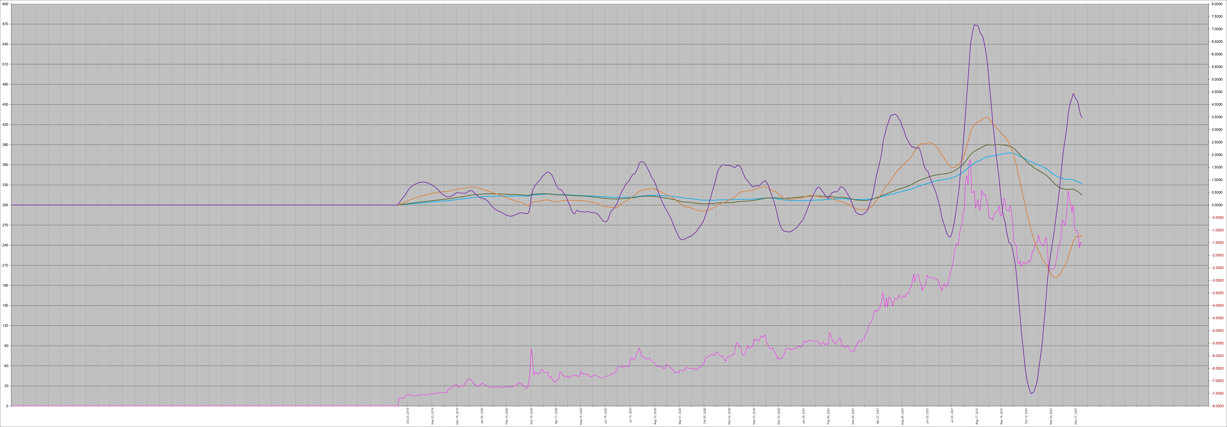
BioNTech as at 14 Dec 2021
The BioNTech model is in Euro and taken from the Tradegate platform as it has both the EU and USA trading sessions represented for a more reliable model.

Slide 11

Light blue is the 15mth oscillator and it also went up a little bit but is going down again
BNTX 9 December 2021. Down leg accelerating.
Green is the 12mth oscillator and it also went up a little bit but is going down again
Orange is the 6mth oscillator and it turned up but is topping
Completed a top turn on the 3mth purple oscillator and going down
Pink is the share price

Slide 12
Light blue is the 15mth oscillator and it is going down.
BNTX 14 December 2021.
Short term oscillators are indicating a possible sideways move but the momentum on long oscillators are increasing. The risk remains to the downside.
Green is the 12mth oscillator and it is going down.
Orange is the 6mth oscillator and it lost its upwards momentum leveling out but not yet in a down phase also indicating a possible sideways move.
A top turn on the 3mth purple oscillator which is losing momentum. An early indication of a possible sideways move.
Pink is the share price

Slide 13
The BioNTech model is weakening, signaling from 28 October 2021 market trading days. The up move was strong enough to generate a buy signal even though the setup was weak. Acting on a weak buy signal is risky as is demonstrated here but the Omicron variant was probably to blame, and the buy may have done better without Omicron. The problem with the oscillators out of synchronization was always going to be an issue for this buy signal. Deteriorating setup also losing the 6mth oscillator though it is still transitioning to negative.

Slide 14
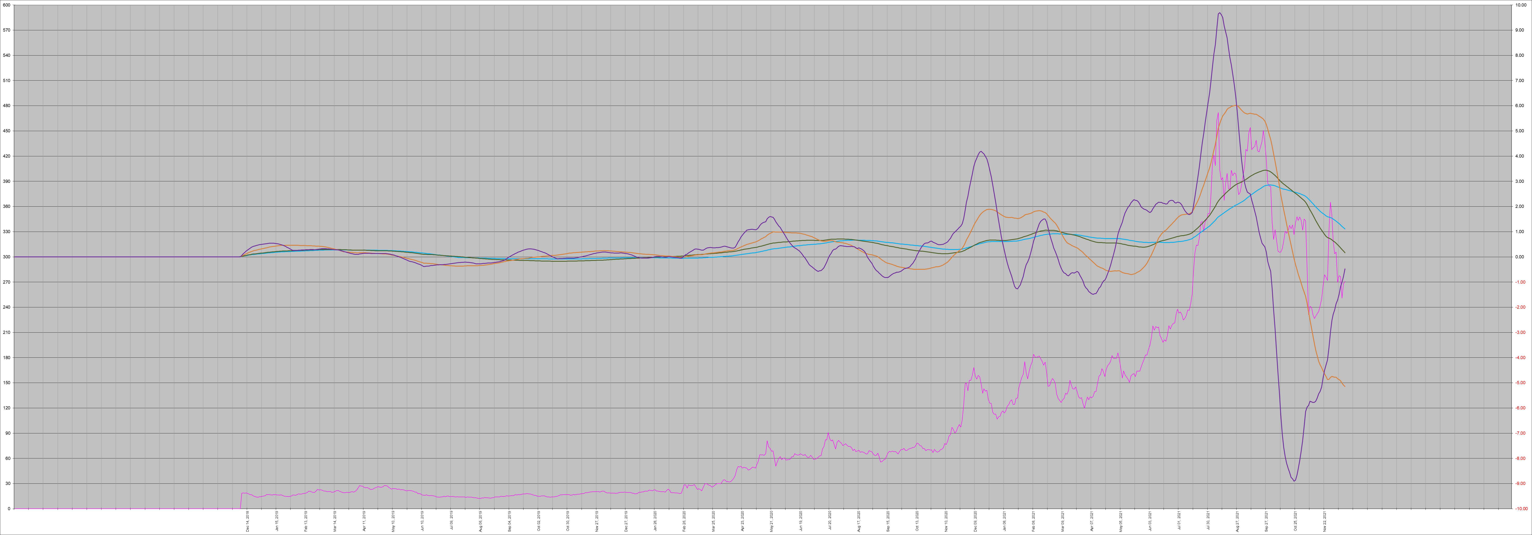
Moderna as at 14 Dec 2021
The Moderna model is the weakest of the three (BNTX, MRNA, NVAX)

Slide 15

Light blue is the 15mth oscillator and it also went up a little bit but is going down again
MRNA 9 December 2021. Down leg accelerating.
Green is the 12mth oscillator and it is still going down
Orange is the 6mth oscillator and it turned up but lost the up and is going down again
Putting in a top turn on the 3mth purple oscillator
Pink is the share price

Slide 16
Light blue is the 15mth oscillator and it is going down
MRNA 14 December 2021.
Made a short term up move which is not strong enough to counter the down momentum in all the other oscillators. Further downside risk and Moderna may lose its S&P 500 index slot if its market capitalization continues to deteriorate.
Green is the 12mth oscillator and it is still going down
Orange is the 6mth oscillator and it is going down again
The 3mth purple oscillator is holding on for a short term respite
Pink is the share price

Slide 17
The Moderna model is the weakest model of the three (BNTX, MRNA & NVAX), signaling of the trading days from 28 October 2021. The 3mth oscillator is still bullish. All the other oscillators are negative and momentum is accelerating to the downside.

Slide 18

Conclusion
The up move since October 2021 was taking place against a long-term unresolved down momentum in the three covid vaccine manufacturers, BNTX, MRNA & NVAX.
There was a fair risk that the up move could fail, and another down leg could initiate.
The arrival of Omicron did exactly that so far and the down leg is now well underway.
NVAX got a special event EMA news of potential approval by 16 December 2021 which gave it a one day 28% up move but did not alter the larger down leg. It’s model deteriorated even though it has further potential for positive catalysts.

