Slide 1

Short Recommendation
Matthew Greenberg
Rutgers University
Jonathan Chang
Queen’s Smith School of Business
Chris Kapasakis
Rutgers University
Group 1 Automotive (NYSE:GBI)
Market Capitalization: $1.38B
Current Price: $59.03 (April 17, 2016)
Price Target: $30

Slide 2










Company Overview
Business description
GPI is third largest automotive retailer in the US selling new and used cars, light trucks, and vehicle parts.
  Behind AutoNation and Penske Automotive Group with $10.6B in 2015 revenues.
  Retails approximately 300,000 new and used vehicles annually
Additionally involved in vehicle financing, service and insurance contracts, and maintenance and repair
212 franchises, 162 auto dealerships, 37 collision centers
2015 Segmented Unit Sales
Brand Portfolio
Sources: Company Website, GP Investor Presentation

Slide 3
Investment Thesis
outline
1. Aging Car Fleet
New car sales over the past few years will soon become used cars – which will be competition for GPI's new cars and reduce gross margin.
2. Bubble in Auto Loan Financing
Rising rates will lead less ability to finance cars, with the auto-loan bubble already beginning to burst.
3. Foreign Exchange Headwinds
Currency issues will become severe in Britain and Brazil, hurting overseas profit.
4. Bleak Domestic Markets
Bleak prospects in core US market. Volkswagen makes up over 4% of US dealers, and the likely fallout from VW's emissions scandal will hurt sales.
5. Cash Flow Instability
GPI has a weak balance sheet, with very heavy borrowing to pay dividend and buybacks not likely to be able to continue.

Slide 4
1
Aging Car Fleet
2
Bubble in Auto Loan Financing
3
Foreign Exchange Headwinds
4
Bleak Domestic Markets
5
Cash Flow Instability

Slide 5
Increase in Used Cars to Hurt GPI
Total Vehicle Sales
Increasing sales
Past few years have seen huge increase in car sales
Low gas prices more recently have further helped the driving frenzy
Used Vehicles Becoming “Newer”
Decreasing age
Used cars are becoming younger
The massive amount of cars sold over the past few years will now become used cars
  There were 7.3% more sales of used vehicles (that were 3 years old or less) in Q3 2015 than in Q3 2014
Sources: US Bureau of Economic Analysis

Slide 6
Increase in Used Cars to Hurt GPI
2015 – 2014 Difference
Increasing competition
More competition means less pricing power and lower margin:
  GPI has seen their gross margin begin to decline
  As more cars enter the market, this decline will be more pronounced
Sources: GPI 10k Filing

Slide 7
1
Aging Car Fleet
2
Bubble in Auto Loan Financing
3
Foreign Exchange Headwinds
4
Bleak Domestic Markets
5
Cash Flow Instability

Slide 8
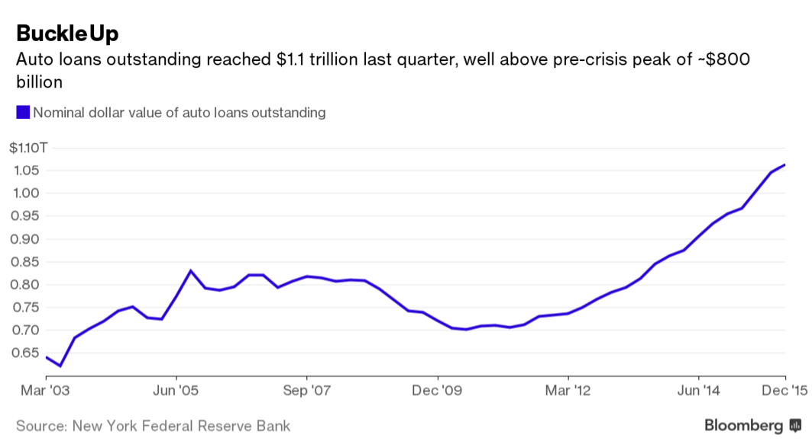
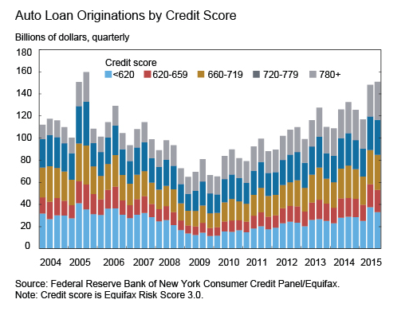
Auto Loan Financing:
On the Verge of Bursting
Auto Loans Outstanding (Nominal Dollar)
Increasing loan value
Recent increase in car sales largely a result of credit availability
  “Auto loans outstanding reached $1.1 trillion last quarter, well-above pre-peak of ~$800B”
GPI has helped fuel this through Buy Here Pay Here (BHPH) program
Outstanding car loans continue to skyrocket
Auto Loan Origination by Credit Score
Decreasing credit score
The massive increase in credit is being created in non prime and sub-prime
Beginning to reach levels not seen since 2005 and 2006
Sources: Bloomberg, New York Federal Reserve Bank, Federal Reserve Bank of New York Consumer Credit Panel/Equifax

Slide 9
Auto Loan Financing:
On the Verge of Bursting
YoY Change in Open Loan Volume
Lending acceleration
Sub-prime lending is accelerating as dealers struggle to find new car buyers
Sub-prime lending is the fasting growing share of the auto-loan market
Prime auto lending could be approaching bubble status as loan outstanding amounts continue to reach all time highs
Deteriorating credit
As the credit of buyers worsen, and loan debt held by sub-prime increases, the terms struck with lenders are becoming suspect
In 2010, just over 30% of car buyers struck terms of payment above 67 months. Now, it is nearly double at 60%. Source: Edmunds
As a result, payments are decreasing and unsophisticated buyers are tricked into believing they can afford cars when they are in reality unable to
Sources: Experian-Oliver Wyman Market Intelligence Reports

Slide 10
Auto Loan Financing:
On the Verge of Bursting
Forced terms of payment
Lenders are forcing lower quality buyers into longer term loans
  Generating higher volumes and short-term performance
  On the basis of optimistic projections for future loan environment
  Lack of conscience for sustainability of industry
Average New Loan Term
Sources: Experian Automotive

Slide 11
Auto Loan Financing:
On the Verge of Bursting
Average New Loan Rate
sustainability
These gains in car sales are unsustainable
Sub-prime buyers are taking on much more debt with much higher rates
Interest rates are up slightly YoY
GPI implications
Defaults are likely as interest rates begin to normalize
GPI is hurt because they have $377 million in revenue from their financing line of business
Destruction of easy credit would make auto-sales take a serious hit
Reliance of financing to purchase vehicles has reached record highs
Average Used Loan Rate
Sources: Experian Automotive

Slide 12
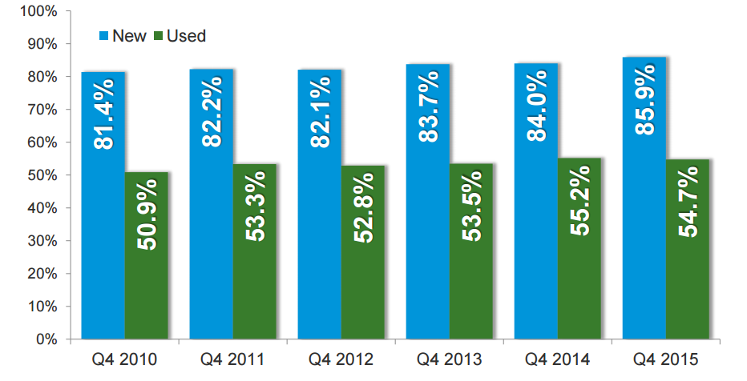
Auto Loan Financing:
On the Verge of Bursting
Reliance on unsustainable financing
Reliance of financing to purchase vehicles has reached record highs
If this market begins to contract, auto dealers are likely to be hard hit
Percentage of Vehicles with Financing
Sources: Experian Automotive

Slide 13
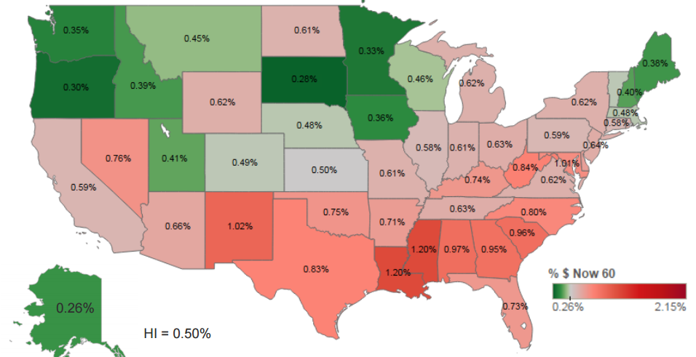
Auto Loan Financing:
On the Verge of Bursting
Where the risk lies
GPI more at risk than most, as 73.5% of 2015 auto unit sales are in states with higher than average 60 day delinquency rates
Geographic Representation
Sources: Experian-Oliver Wyman Market Intelligence Report

Slide 14
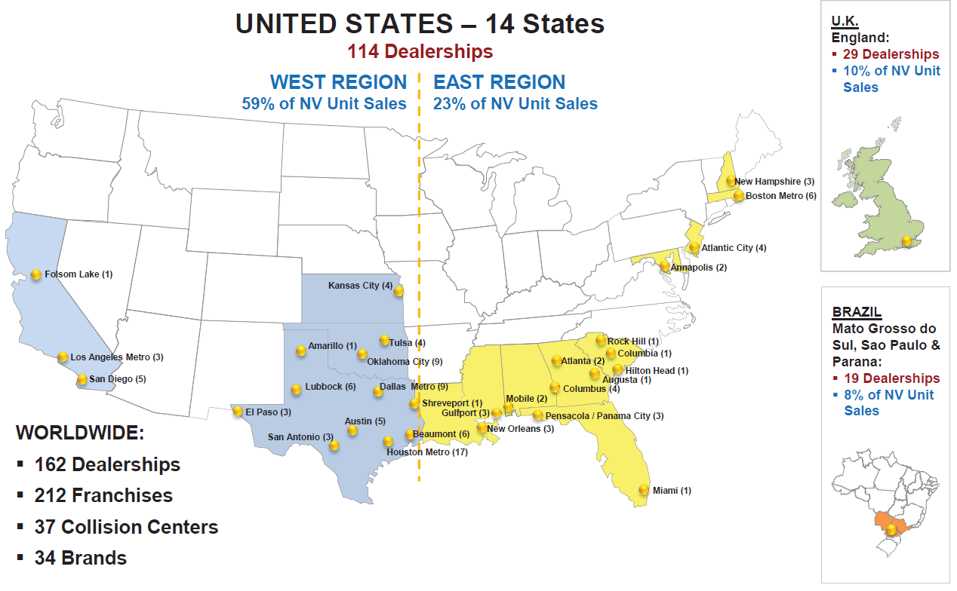
Auto Loan Financing:
On the Verge of Bursting
GPI Exposure
Sources: Experian-Oliver Wyman Market Intelligence Report

Slide 15
1
Aging Car Fleet
2
Bubble in Auto Loan Financing
3
Foreign Exchange Headwinds
4
Bleak Domestic Markets
5
Cash Flow Instability

Slide 16
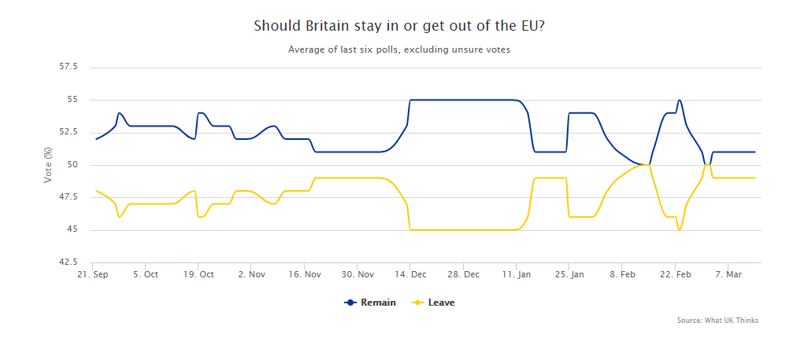
International Issues
Brexit
Britain is supposedly a safe market, but it could take investors by surprise
Prospect of Brexit (Britain leaving the European Union) is becoming more likely
Those wishing to leave have nearly closed the gap with those wishing to stay with a populist undertone
Should Britain Stay In or Get Out of the EU?
Sources: What UK Thinks

Slide 17
International Issues
USD per 1 GBP
British Pound
Many economists speculate Brexit would be disastrous for the strength of the pound
Pound has already been weakening versus the dollar over past couple years
-19%
British car sales
10.7% of new car unit sales came from the UK in 2015, up from 8.8% in 2014
Increasingly reliance on Great Britain means increasing currency risks
Many economists warn Brexit could hurt British economy and be detrimental to growth, which would hurt consumer demand and retail car sales
Sources: Forex Forum, Global View

Slide 18
International Issues
Brazilian GPI Vehicle Sales
Brazil
Brazil is a much larger threat to GPI investors
Worries persist as it remains to be seen if Brazil even has a functioning government
Brazil made up 8.3% of new car sales in 2015
Brazilian economy is deteriorating rapidly, hurting GPI’s operations
Average Retail Price
Gross Margin erosion
Fewer units sold was further exacerbated by currency issues and currency adjusted sales prices
This issue resulted in a gross margin decline of 13.6% for new cars and 44.4% for used cars
Sources: GPI 10k Filing

Slide 19
International Issues
USD per 1 BZL
Brazilian Real
Issue continue to get worse as Brazilian currency weakens
Rising rates in the US are likely to further strengthen the USD versus BRL
BRL has already fallen over 50% versus USD in the past 5 years
-63%
Sources: Investing.com

Slide 20
1
Aging Car Fleet
2
Bubble in Auto Loan Financing
3
Foreign Exchange Headwinds
4
Bleak Domestic Markets
5
Cash Flow Instability

Slide 21
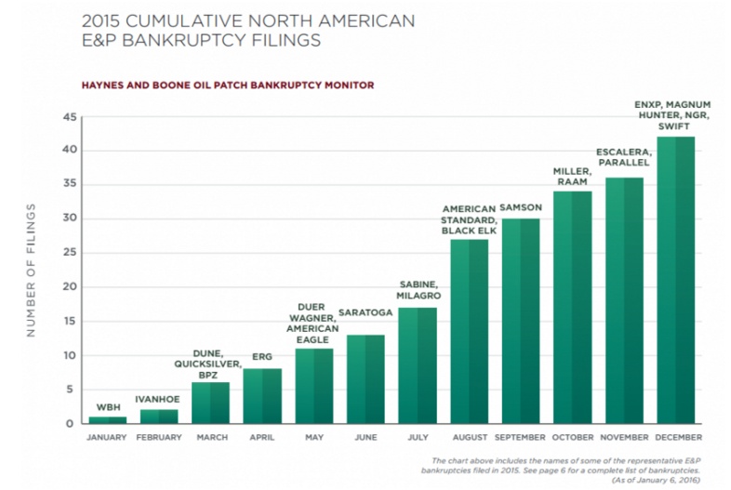
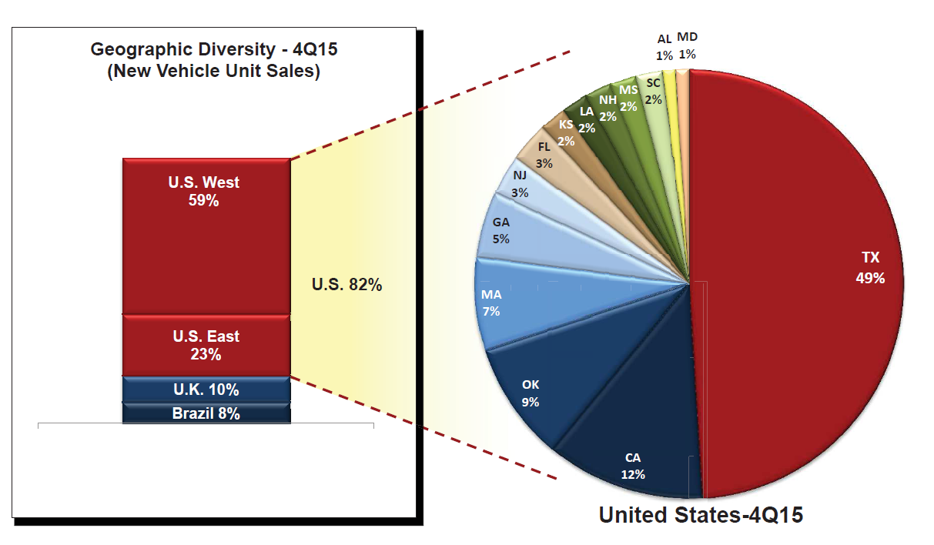
Trouble in Domestic Markets
2015 NA E&P Bankruptcy Filings
Energy exposure
Prospects are becoming bleak in GPI’s North American core market
Energy sector is continuing to suffer and more bankruptcies are likely
Texas makes up 38.7% of GPI’s unit sales in the US
Nearly 20,000 jobs were lost in the energy sector in 2015, and 2016 is expected to be worse
GPI Unit Sales by Geography
GPI Energy influence
49% of US sales come from Texas
  39% of total sales come from Texas
  21% of total sales come from Houston
Lower income customer base provides pessimistic outlook for future sales in the region
Sources: Haynes and Boone Oil Patch Bankruptcy Monitor

Slide 22
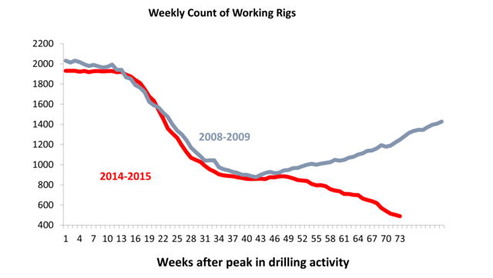
Trouble in Domestic Markets
2Yr Relative Performance
GPI Energy Influence
Despite large exposure to energy, GPI does not seem to intuitively lose from oil price declines
  Automobile sales have increased with the decline
Has yet to be fully priced into stocks with coming earnings and further exit of oil produceres
Weekly Count of Working Rigs
employment
Any hit in employment in the energy sector would hurt consumers in GPI’s market
CEO Hesterberg on Q4 results: "significantly hampered by the negative impact of continued oil and gas price decreases on the economy in our prime markets of Houston, Oklahoma and Texas in general."
Likely to continue
Sources: University of Houston, Factset

Slide 23
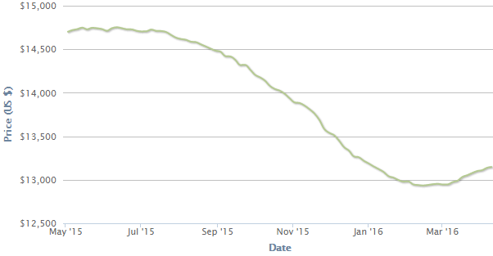
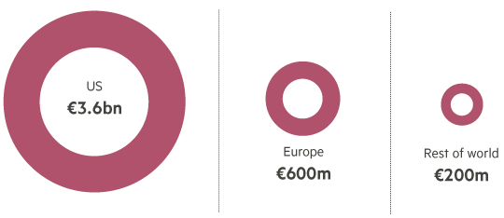
Volkswagen Troubles
Volkswagen Used Car Prices Over Time
Supplier Risk
GPI has 6 Volkswagen dealerships in the US, out of 142 total (4.2%)
Volkswagen/Audi/Porsche made up 6.9% of sales in 2015
Demand continues to decline leading to decrease in used car prices
  VW used car value has decreased faster in past year than industry benchmark (2% vs. 10%)
YoY % (Apr ’16) Decline in VW Models
Estimated Cost of Fixing VW Scandal Cars
Sources: CarGurus, Financial Times, Société Générale

Slide 24
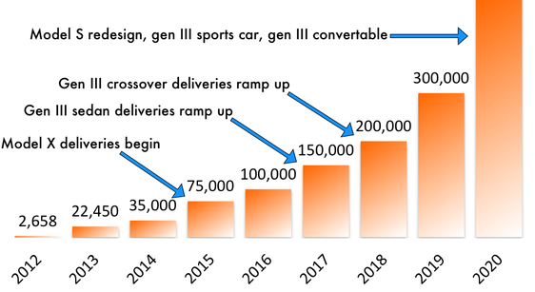
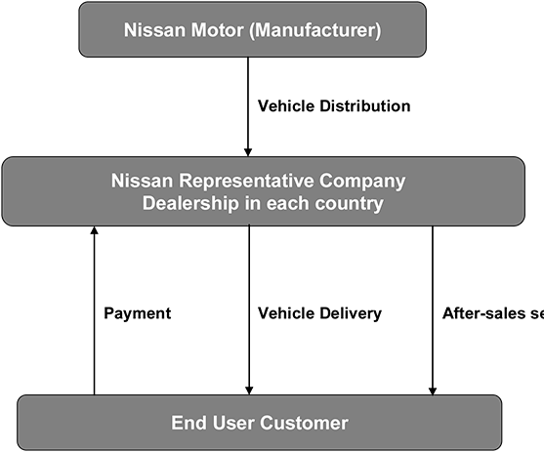
Trouble with Sales Model
Potential Tesla Vehicle Deliveries
Direct sales model risk
500,000
Tesla’s direct sales model could catch on if consumers become fed up with cars salesman
State regulations seem to be the only thing barring this model from becoming more prominent
Ford in 2009 attempted to sell cars online, but was threatened with $10,000 a day fine in Texas
Direct sales could do what Amazon did to retailers
  Minimization of profit margins for every distributer
States such as New Jersey have begun to open their doors to direct manufacturer sales
  Increase in direct sales could decrease new car prices. In turn, used cars will decrease in response.
Traditional Indirect Model
Sources: Nissan Aid, Rik Auto,, Mother Jones

Slide 25
1
Aging Car Fleet
2
Bubble in Auto Loan Financing
3
Foreign Exchange Headwinds
4
Bleak Domestic Markets
5
Cash Flow Instability

Slide 26
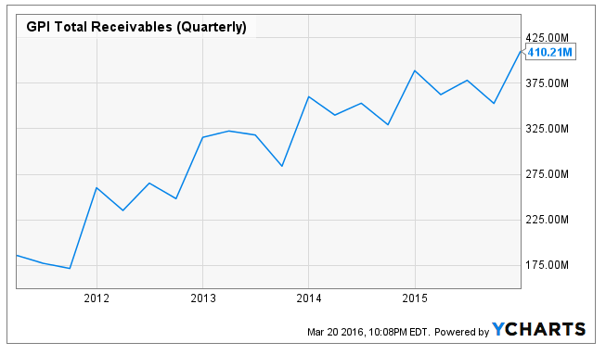
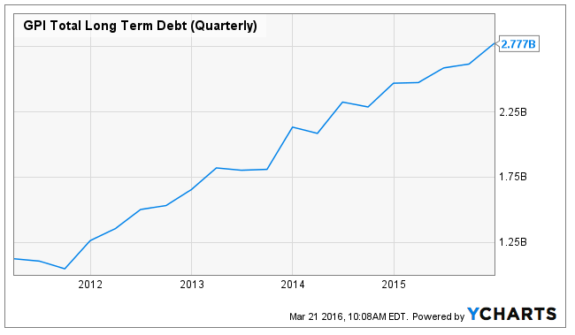
Weakened B/S Beginning to Emerge
GPI Quarterly Receivables
Receivables
GPI’s balance sheet shows a company that would be decimated by bursting auto-loan bubble
Receivables have been increasing nearly in sync with growth of auto financing
Delinquencies would have disproportionate affect on GPI’s ability to operate
GPI Quarterly Debt Amounts
Debt
GPI has been taking out massive amounts of debt to pay its dividend and fund buybacks
GPI’s debt over the past 5 years has doubled to about $2.8 Billion
Sources: YCharts, GPI 10k Filing

Slide 27
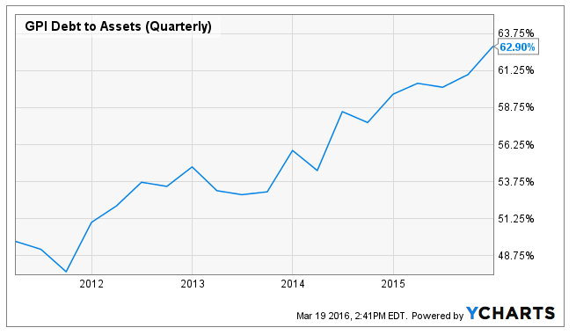
Weakened B/S Beginning to Emerge
GPI Debt / Assets
Receivables
Debt is starting to seem excessive
Debt to equity ratio is over 300%
Debt to assets continues to increase, now over 60%
If car market were to crash, a writedown of assets would exacerbate issue and make raising capital through debt even more difficult
CAPITAL ALLOCATION
Further borrowing
Even with the massive increase in receivables, GPI debt growth still outpaced that
GPI recently announced they would double their buybacks
Buybacks and dividends will now be 100% of cash flow from operations
To pay for growth and capex, GPI will need to borrow even more
Regardless of whether auto-loan bubble bursts, GPI will not be able to continue with these expensive buybacks
Debt is already rated as junk
Sources: YCharts, GPI 10k Filing

Slide 28
Valuation

Slide 29
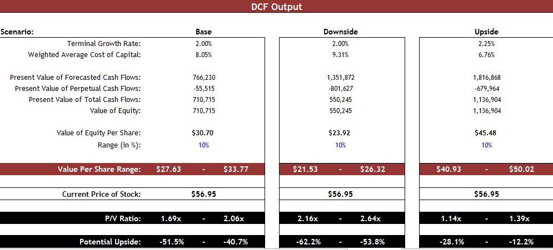
Valuation
Assumption
  Conservative DCF model
  Assumes GPI continues same pace of buybacks for 2 years, when in reality only 9 months are funded
  Model assumes WACC increases to 8.05% from 5.8% as debt expense increases
  Assumes margin falls 2% annually

Slide 30
Valuation
Historical Price / Earnings
Premium multiple
GPI is trading at valuations above those of its peers, likely due to dividends and buybacks
This provides investors with a greater risk-reward play
Top 10 US Retailers by Sales (2014)
Sources: Bloomberg, Factset, GPI Investor Presentation

Slide 31
Valuation
Business / Credit Profiles
Valuation Multiples
Sources: Factset

